Slide 1
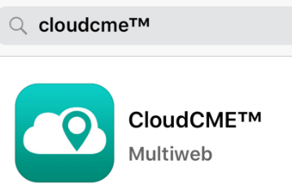

Update your Profile This ensures you receive full CE credit
In the Mobile App: Download the CloudCME app from the App Store, and enter organization code: UVA
Or on your Computer: Visit www.CMEVillage.com
Sign In (If you’ve attended a UVA CE course before, you already have an account)
UVA Employees: Log-in with your UVA Computing ID
Non-Employees: Log-in with your Email and Password
Select “Forgot your Password” to create a password.
Update your profile: Select “MyCE” then “My Profile” and complete the ENTIRE form to ensure you receive all credit you are eligible for.
First Time attending a UVA CE Course? Select “Create an Account.”
Questions? Email uvace@uvahealth.org

Slide 2
Claim Credit Via Text or on your Computer
Text your Attendance:
The activity code for today’s session is: 31725
Text this code to: 1-855-474-8287
Claim Credit at UVA.cloud-cme.com:
Log into your account, select My CE, then select Claim Credit.
If you don’t know your password, select “forgot password.”
You may text attendance 15 minutes prior to, during, and up to 8 hours after the session.
NOTE: If you have never received CE credits awarded by UVACE, visit uva.cloud-cme.com and click the “Sign Up Now” button.
Questions? Email uvace@uvahealth.org

