Slide 1
Measles at the Doorstep: Pediatric Lessons From a Local Exposure Event
Katherine Moyer, DO
Pediatric Infectious Diseases

Slide 2
Objectives
By the end of this presentation, participants will be able to:
Recognize the clinical presentation and early signs of measles in pediatric patients.
Assess measles exposure history and apply appropriate post exposure management strategies.
Implement proper steps when measles is suspected, including isolation procedures and coordination with infection prevention and public health.

Slide 3
Case 1
Presentation

Slide 4
Case Presentation
8 Jan.
15 month old unvaccinated male returns from Pakistan on January 8
10 Jan.
Onset of fever and cough with worsening diarrhea
12 Jan.
Development of conjunctivitis
13 Jan.
PM Pediatrics
Ongoing fever, conjunctivitis, and erythematous papules around mouth; atopic dermatitis noted on trunk and extremities

Slide 5
Case Presentation
15 Jan.
Fairfax ED
Persistent high fevers, bilateral conjunctivitis, bilateral otitis media, and gingivostomatitis with discrete oral lesions
16 Jan.
Fairfax ED
Worsening respiratory distress with stridor, right upper lobe pneumonia on chest radiograph; required admission with high-flow nasal cannula oxygen
17 Jan.
Continued stridor, fever, cough; development of periorbital edema with mild erythema
18 Jan.
Worsening rash spreading from face to trunk; transferred to negative pressure isolation; measles testing sent
19 Jan.
Measles confirmed by health department testing

Slide 6
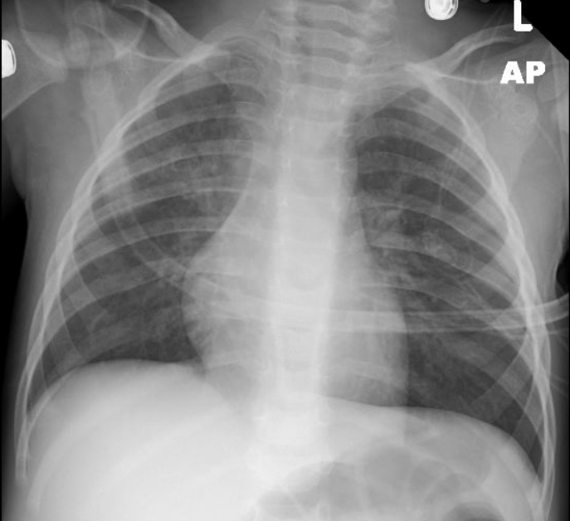
Clinical Course
Required PICU transfer for worsening respiratory distress
Multiple courses of racemic epinephrine and dexamethasone for recurrent stridor with eventual prednisolone course with taper
7 day course of ceftriaxone for secondary bacterial pneumonia
Received Vitamin A
19 day hospitalization

Slide 7
Complications
Secondary bacterial pneumonia (right upper lobe) - occurs in 1-6% of measles cases
Bilateral otitis media - occurs in 7-9% of measles cases
Diarrhea - occurs in 8-10% of measles cases
Laryngotracheobronchitis with stridor - required multiple courses of racemic epinephrine and dexamethasone; ENT evaluation revealed thickened, edematous epiglottis
Gingivostomatitis/mucositis
NEJM Measles 2025

Slide 8
Case 2
Presentation

Slide 9
Case Presentation
20 Jan.
2 year old brother developed cough, congestion, conjunctivitis and few lesions around mouth; Measles testing positive by health department
25 Jan.
Fairfax ED
Persistent high fever, poor oral intake, mucositis; admitted with dehydration and hypoxemia requiring admission; rash noted around mouth
26 Jan.
Rash spread from face to trunk and extremities; periorbital edema and mucositis noted
27 Jan.
Persistent fever and increased work of breathing; repeat chest radiograph showed left upper lobe pneumonia; blood culture positive for H influenzae

Slide 10
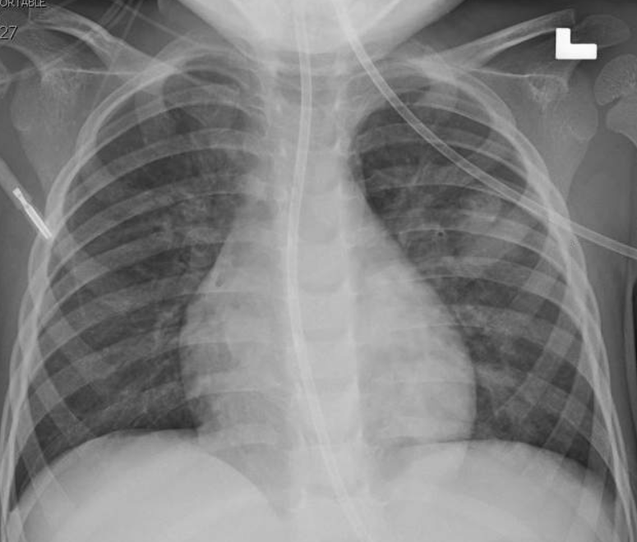
Clinical Course
Completed 7 day course of ceftriaxone for left sided pneumonia and H influenzae bacteremia
9 day hospitalization

Slide 11
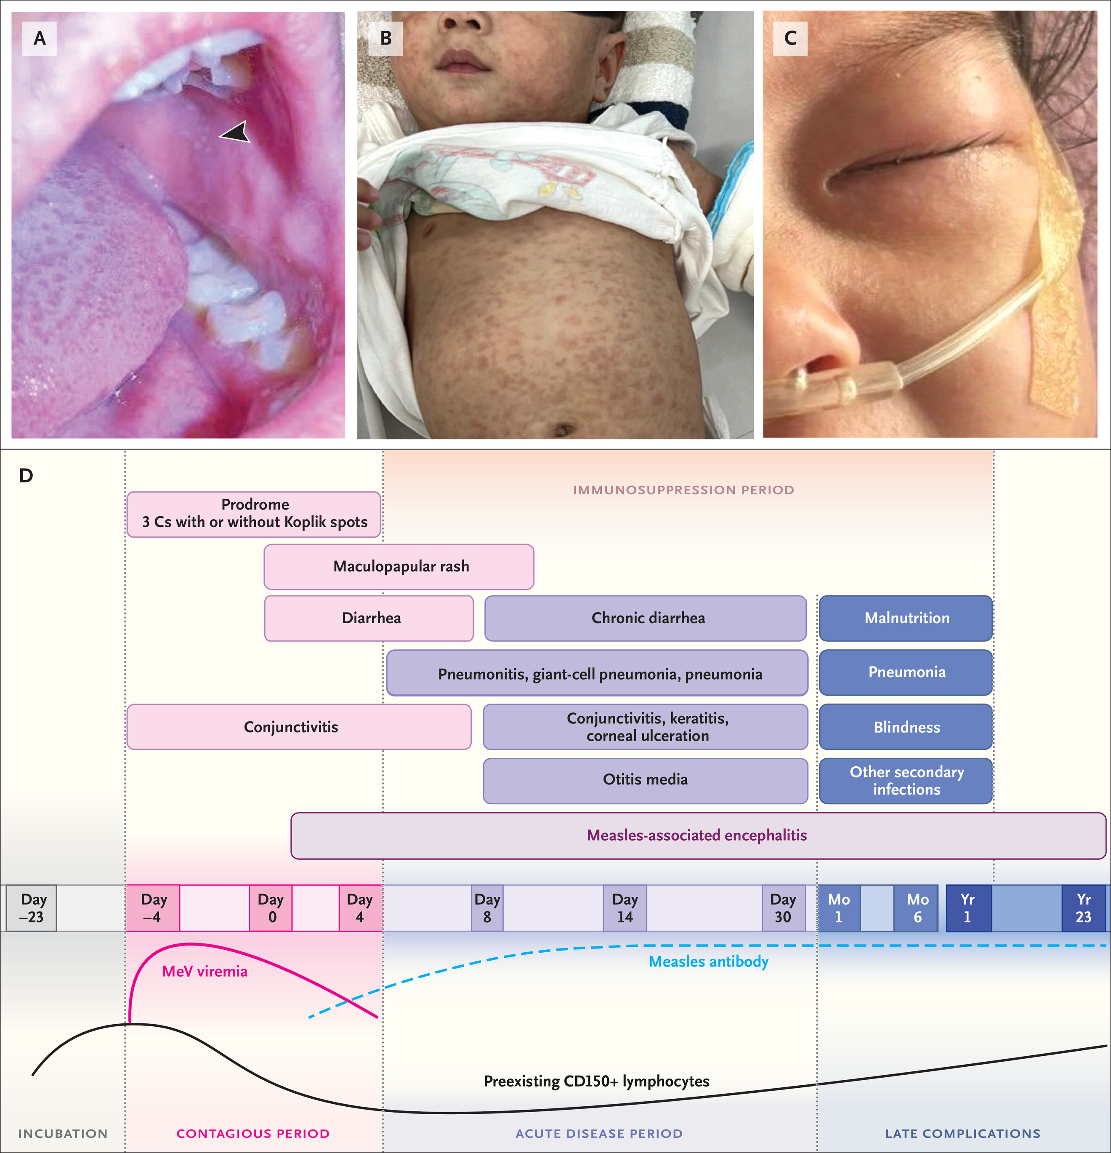
Measles Presentation
Prodrome: Three Cs
  Cough
  Coryza
  Conjunctivitis
Koplik spots
  1-2 days prior to rash
Contagious 4 days prior and 4 days after the rash
Do LAH, Mulholland K. N Engl J Med2025;393:2447-2458
Notes:
Koplik spots in up to 70% of patients

Slide 12
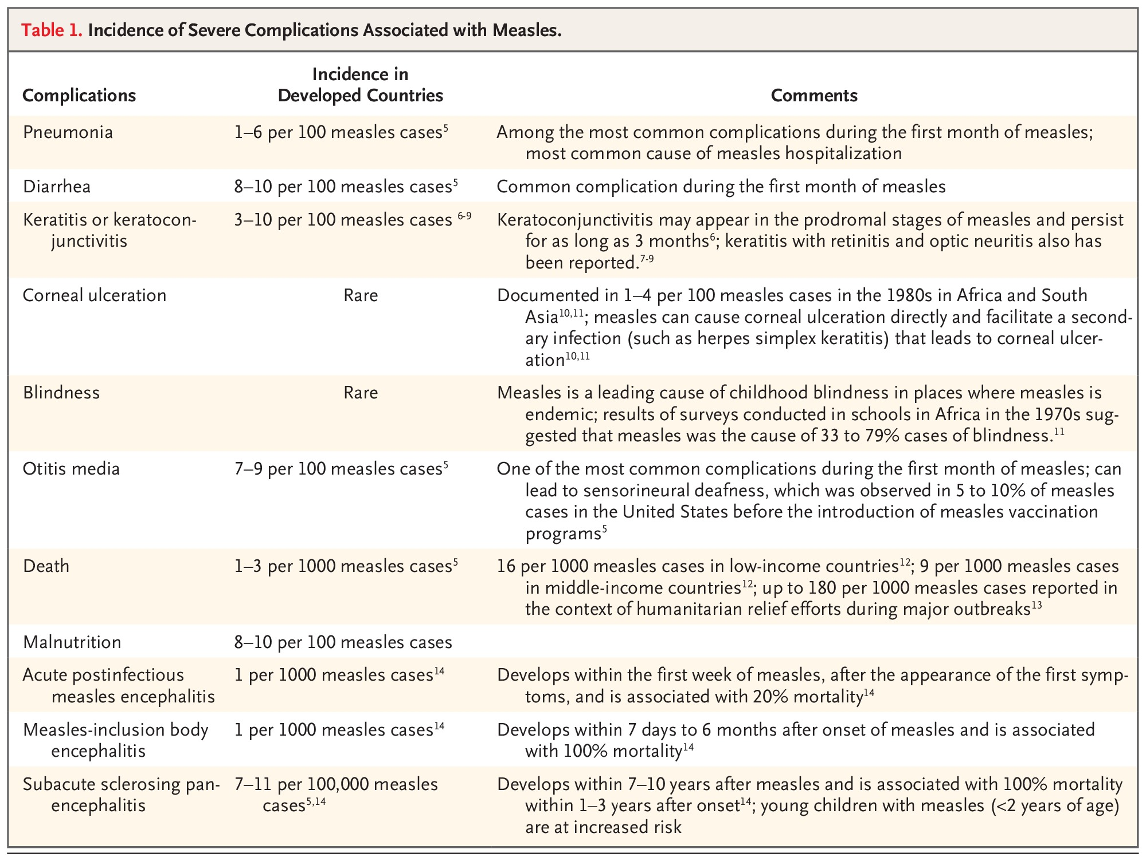

Incidence of Severe Complications Associated with Measles.
Do LAH, Mulholland K. N Engl J Med2025;393:2447-2458
Notes:
Table 1 Incidence of Severe Complications Associated with Measles.

Slide 13
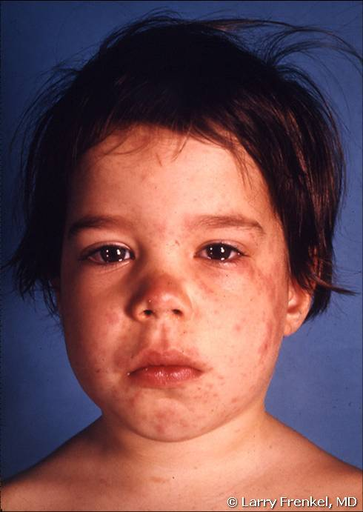
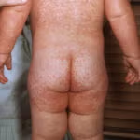
Clinical Features
2024 AAP Red Book

Slide 14
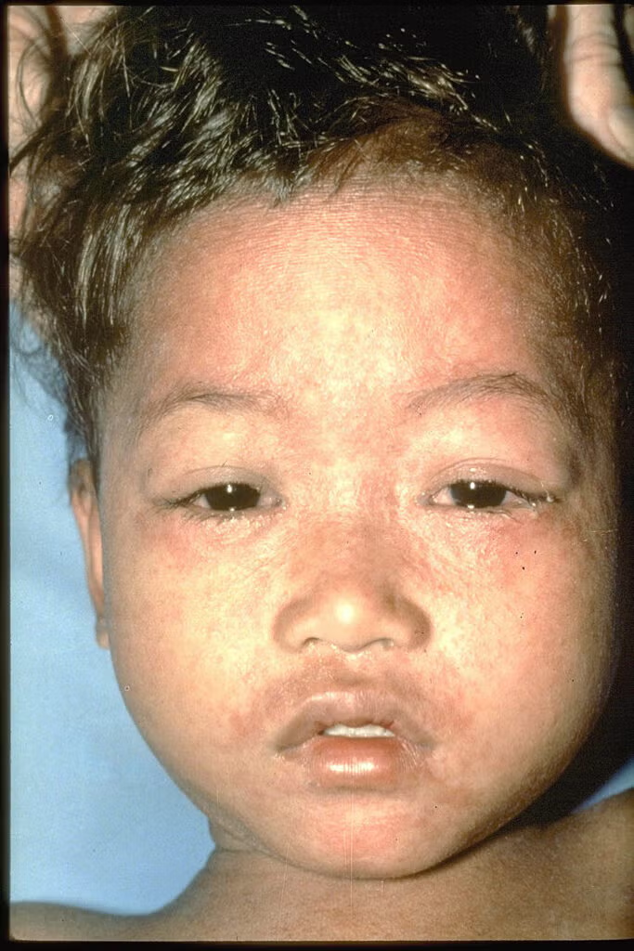
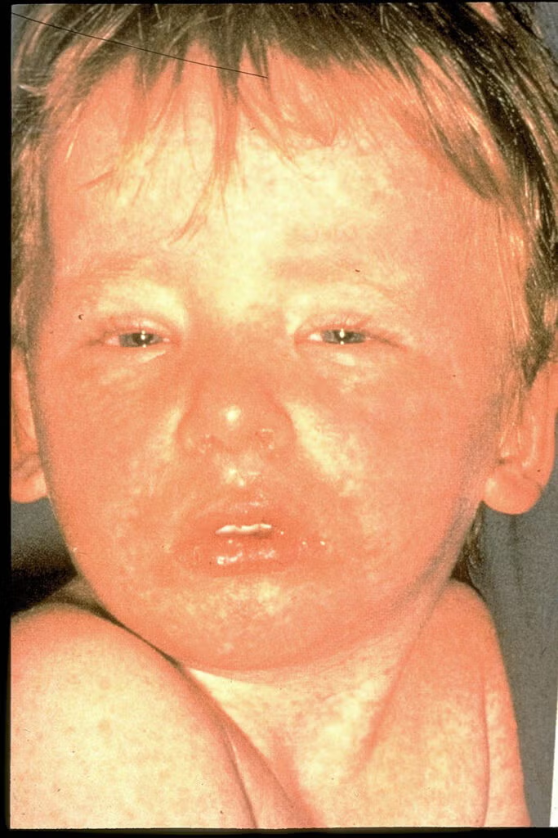
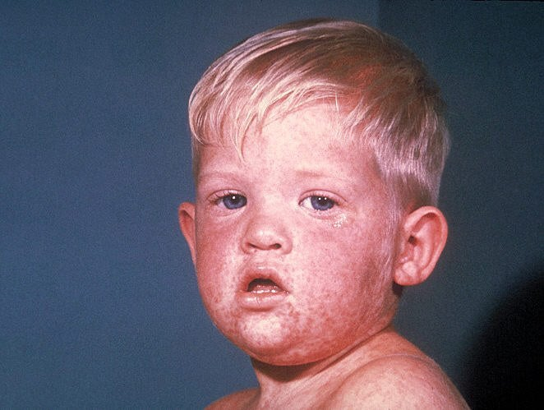
Clinical Features
CDC

Slide 15

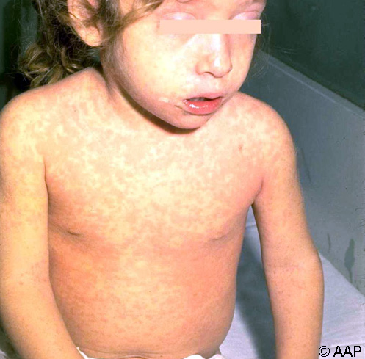
From: Measles
Red Book: 2024–2027 Report of the Committee on Infectious Diseases, 2024
Figure Legend:
Child with rubeola who exhibited an appearance of feeling miserable.
Date of Download: 2/4/2026
Copyright © 2026 American Academy of Pediatrics. All rights reserved.

Slide 16
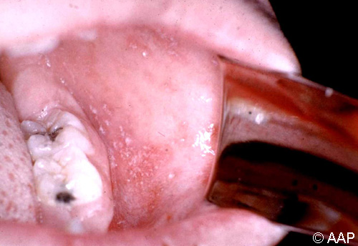
From: Measles
Red Book: 2024–2027 Report of the Committee on Infectious Diseases, 2024
Figure Legend:
Measles (rubeola). Koplik spots on second day of rash. Note characteristic white lesion with erythematous margin.
Date of Download: 2/4/2026
Copyright © 2026 American Academy of Pediatrics. All rights reserved.

Slide 17
Exposure Details

Slide 18
Exposure Details
Inova Children’s Emergency Department, 3300 Gallows Road, Falls Church:
- Jan 15, 2026: 7:30PM–10:00PM
- Jan 16, 2026: 8:30PM–11:00PM
Inova Women’s and Children’s Building, Floors 2–10:
- Jan 17, 2026 2:30AM – Jan 18, 2026 5:00PM
Last day for symptoms to appear: Sunday, Feb 15, 2026

Slide 19
Clinical Recommendations
CDC Guidelines / 2024–2027 Red Book followed
MMR offered within 72 hours to eligible unvaccinated patients
Immunoglobulin (IG) offered to <12 months if ineligible for MMR
MMR recipients: monitor for symptoms for 21 days, no quarantine
IG recipients: quarantine 28 days post-exposure
Non-immune, no IG: quarantine 21 days post-exposure
https://www.vdh.virginia.gov/content/uploads/sites/207/2021/10/Measles-PEP.pdf
Notes:
when IVIG is administered, the quarantine period extends beyond the standard timeframe because passive antibodies may modify rather than completely prevent disease, potentially delaying symptom onset or creating atypical presentations that are harder to detect.

Slide 20
Exposures
Total Exposed
636
PEP Recommended
289
IVIG Recommended 261
MMR Recommended
29
PEP Not Indicated 332
IVIG Received
135
IVIG Declined
11
Unknown
108
MMR Received
10
MMR Declined
1
Unknown
18
Notes:
28; 6-10
15 unknown ED exposures

Slide 21
Considerations for patients who received PEP

Slide 22
PEP Effectiveness
MMR Vaccine
Must be administered within 72 hours of exposure
Effectiveness: 83-100%
IVIG/IMIG
Administer within 6 days of exposure
Effectiveness: 95-100%
MMR is preferred over immune globulin for vaccine eligible persons exposed with 72 hours, as it provides long term immunity
Notes:
Data from meta analysis and includes NYC outbreak in 2013

Slide 23
Considerations for Non-immune Measles exposed patients who received MMR
Between 5-15% of people develop a fever after MMR vaccine 6-12 days after vaccine. Fever is typically 1-2 days. About 5% of people develop a rash after vaccine. These symptoms are due to the vaccine and are not contagious.
If continued fevers for 1-2 days and/or additional onset of other measles symptoms such as cough, runny nose, pink eye (3Cs) then consultation with ID and IP to determine if possible acute measles and in such testing is likely warranted.
Would not plan to test until at least after first 24 hr of fevers. Of note, PCR tests CAN be positive due to measles vaccine as shedding can occur in OP, NP, urine from live virus MMR vaccine and additional genotypic testing must be done at health department level to determine if disease or vaccine. IgM may be positive due to immune response to vaccine vs. disease.

Slide 24
Why the recommendation to give infants less than 6 months of age PEP regardless of maternal immune status?
Maternal antibody transfer is heterogeneous and dependent upon gestational age
Antibody levels are likely lower in infants born to vaccinated parents as opposed to parents with immunity due to wild-type infection (rare in elimination settings)
Susceptibility at birth is low, but not predicted to be 0% in infants born to vaccinated mothers, and appears to wane rapidly within first 3 months of life
Pediatrics 2019 Dec;144(6):e20190630. doi: 10.1542/peds.2019-0630.
BMJ 2010 May 18:340:c1626. doi: 10.1136/bmj.c1626.
Notes:
Other countries such as the UK and Canada recommend IG ppx

Slide 25
Live Vaccines after IMIG or IVIG
Measles prophylaxis | Route administered | Dose | Time to wait until Live vaccines
 | IM | 0.5 mL/kg | 6 months
 | IV | 400 mg/kg | 8 months
Per AAP Red Book: Live intranasal (live attenuated influenza vaccine [LAIV]) and oral (rotavirus vaccine [RV], and Ty21A typhoid vaccine) vaccines do not need to be deferred, because parenterally administered antibodies are unlikely to achieve significant concentrations at mucosal surfaces.

Slide 26
Minimizing Exposure for follow up patients
Scheduling
Schedule quarantined patients last in the day
Before arrival
Provide arrival instructions for symptomatic patients
Instruct patients to call ahead before entering
Upon arrival
Separate from other patients immediately
Provide face mask if age-appropriate
Place in negative pressure AIIR if available
If no AIIR: use private room with door closed
Patient should wear mask throughout stay
Vacate room for 2 hours after patient leaves

Slide 27
Approach to Suspected Measles Case

Slide 28
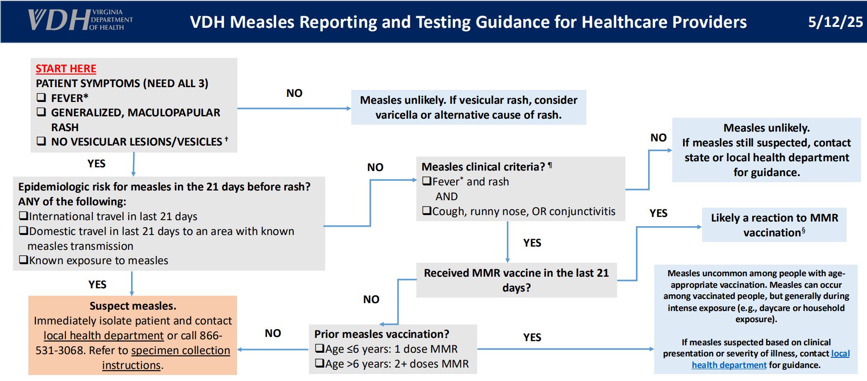

Slide 29
Optimal Specimen Testing
Recommended Specimens for RT-PCR
Nasopharyngeal or throat swab (primary specimen)
Urine (collect in addition to respiratory specimen to increase sensitivity)
Serum for measles-specific IgM antibody
Optimal Timing
Viral RNA detectable for approximately 3 days after rash onset
PCR allows very early case confirmation when clinical symptoms first appear
IgM antibodies not detectable in ~25% of patients within first 72 hours after rash onset
Notes:
NP is highest yield
Combining respiratory and urine increases overall sensitivity

Slide 30
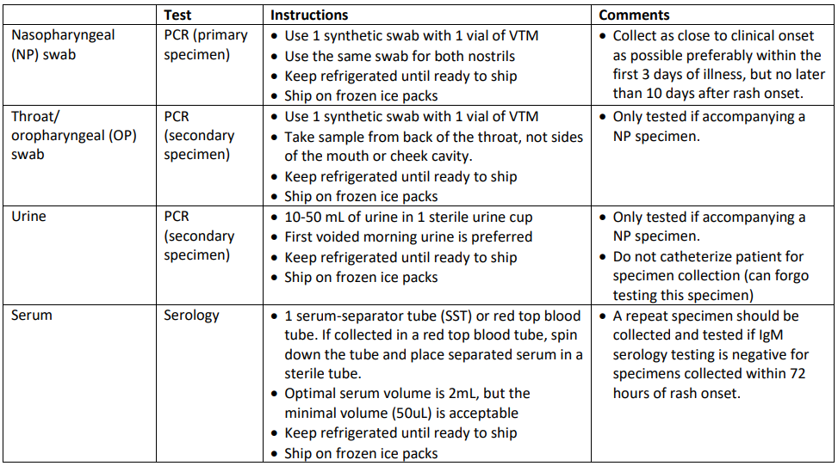
Testing Guidance
https://www.vdh.virginia.gov/content/uploads/sites/207/2021/09/HCP-Instructions-for-Measles-Specimen-Collection.pdf

Slide 31
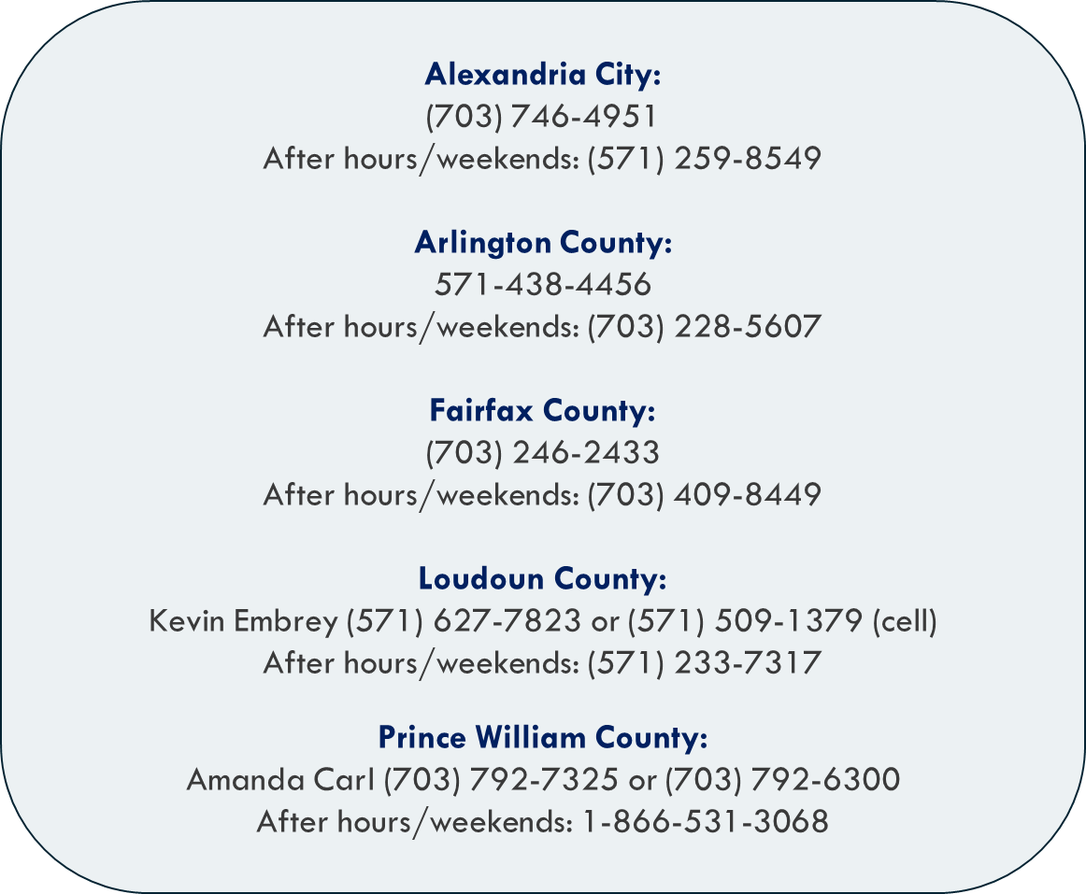
Health Department Contact Information

Slide 32
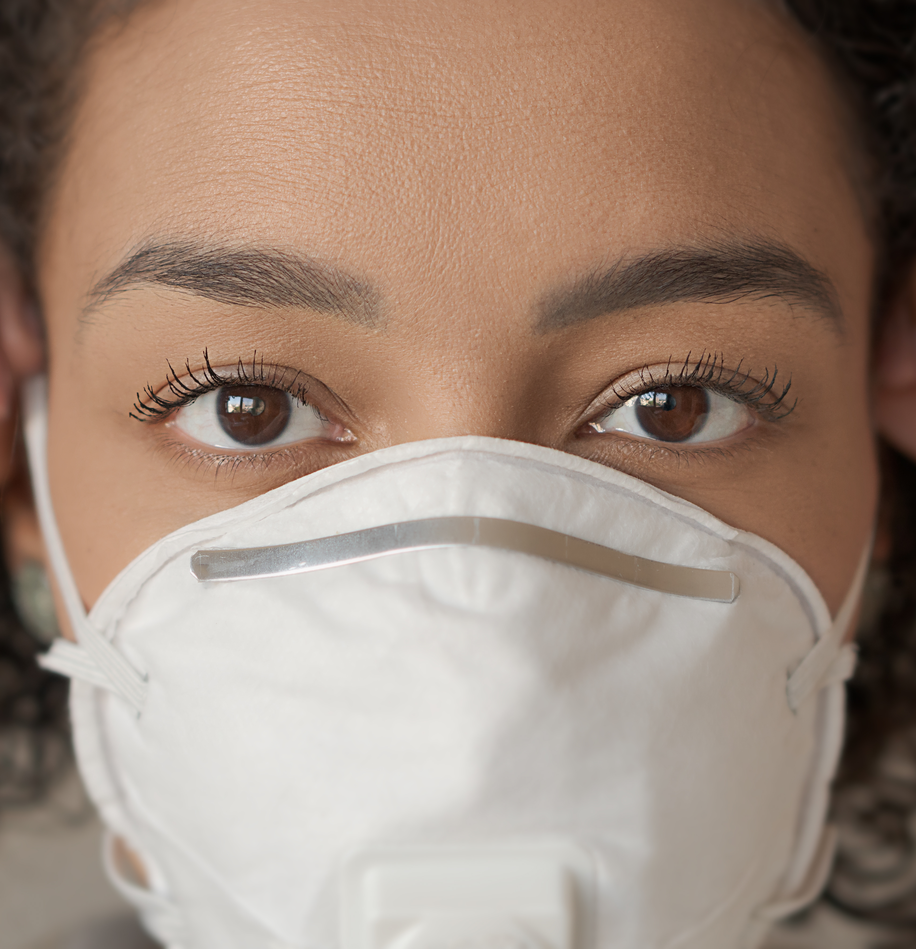
Team Member Infection Prevention
No entry for staff without measles immunity
Use fit-tested NIOSH-certified N95 respirator
Don PPE before entry, doff and discard after exit

Slide 33
After the Visit
Waste management
No special handling required
Dispose PPE and patient items as regulated medical waste
Environmental Cleaning
Standard cleaning/disinfection is sufficient
Use Oxivir-1 (1 min dwell) or Medline Microkill Bleach (3 min dwell)

Slide 34
Lessons Learned
Maintain high clinical suspicion for measles in high-risk populations and initiate immediate airborne isolation
Evaluate and optimize air-handling systems to reduce the risk of widespread airborne exposure
Strengthen coordination with local and state health departments to support timely contact tracing, post-exposure prophylaxis (PEP), and clear public communication

Slide 35
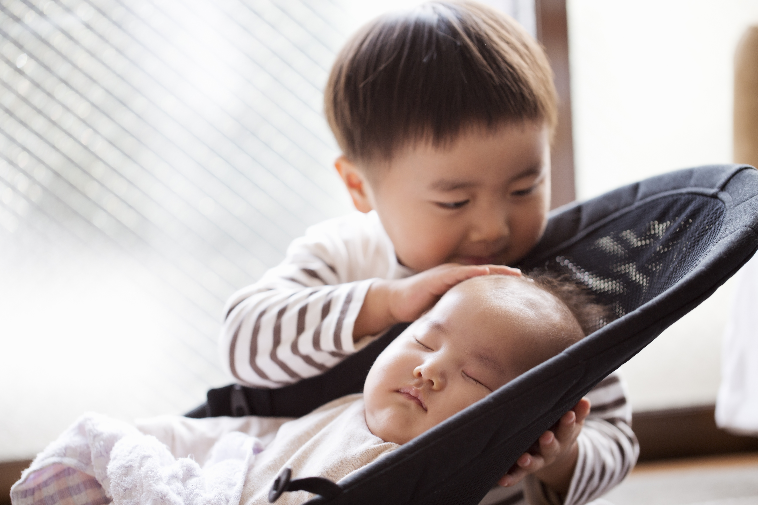
When to consider early MMR Vaccination (6-11 months)
Infants less than 12 months are at highest risk for complications
Infants aged 6–11 months living in or traveling to outbreak areas should receive one early dose of MMR
    This early dose is not counted toward the routine series
    Routine doses still needed at 12–15 months and 4–6 years
    Pediatricians should weigh benefits of early protection vs. slightly lower immune response in younger infants
Notes:
https://www.childrensmercy.org/health-care-providers/evidence-based-practice/cpgs-cpms-and-eras-pathways/measles/measles-vaccination/

Slide 36
Do I need an MMR booster?
Despite evidence of waning immunity, neither the CDC nor WHO recommend routine boosters for fully vaccinated individuals because:
  The primary driver of measles resurgence is failure to vaccinate, not vaccine failure
  High antibody levels induced by a third dose wane quickly (over 1-3 years), providing only temporary benefit
  Over 90% of current US outbreak cases are in unvaccinated individuals
  Breakthrough infections in vaccinated persons generally result in mild illness with lower transmission risk

Slide 37
References
Measles 2025. NEJM. https://www.nejm.org/doi/full/10.1056/NEJMra2504516
VDH Measles Information for Health Care Workers: https://www.vdh.virginia.gov/measles/hcp/
CORI Measles Outbreak Response Dashboard https://cori.centerforhealthsecurity.org/resources/measles-outbreak-response
SC Dept of Health Measles Outbreak page: https://dph.sc.gov/diseases-conditions/infectious-diseases/measles-rubeola/2025-measles-outbreak

