Slide 1
Exocrine Pancreatic Insufficiency (EPI) in
Critical Illness: What do we know?
George Kasotakis, MD MPH FACS FCCM
NYLISPEN, October 2024

Slide 2
Conflicts of Interest
Recipient of Industry Grant (Alcresta, Inc.) to conduct PRPCT on Exocrine Pancreatic Insufficiency (EPI) in pts with MultiOrgan Failure (MOF) in Critical Care

Slide 3
Learning Objectives
Describe Clinical Presentation of EPI in critical illness
Accurately diagnose EPI in critical illness
Appropriately manage EPI in critical illness
Notes:
We will start with some basics of pancreatic development and function, along with why that’s important.
Also, a refresher of fat absorption, of which the pancreas is the most important regulator.

Slide 4
Topics
Pancreas and digestion
Fat absorption
EPI/Cystic Fibrosis
EPI in critical illness
Notes:
We cannot talk about EPI in critical illness without reviewing first the role of pancreas in digestion, physiologic fat absorption,
Cystic fibrosis (the well described case of EPI), before we discuss EPI in critical illness which appears to be by far more common that CF, and thankfully transient.

Slide 5
A. Pancreas and Digestion

Slide 6
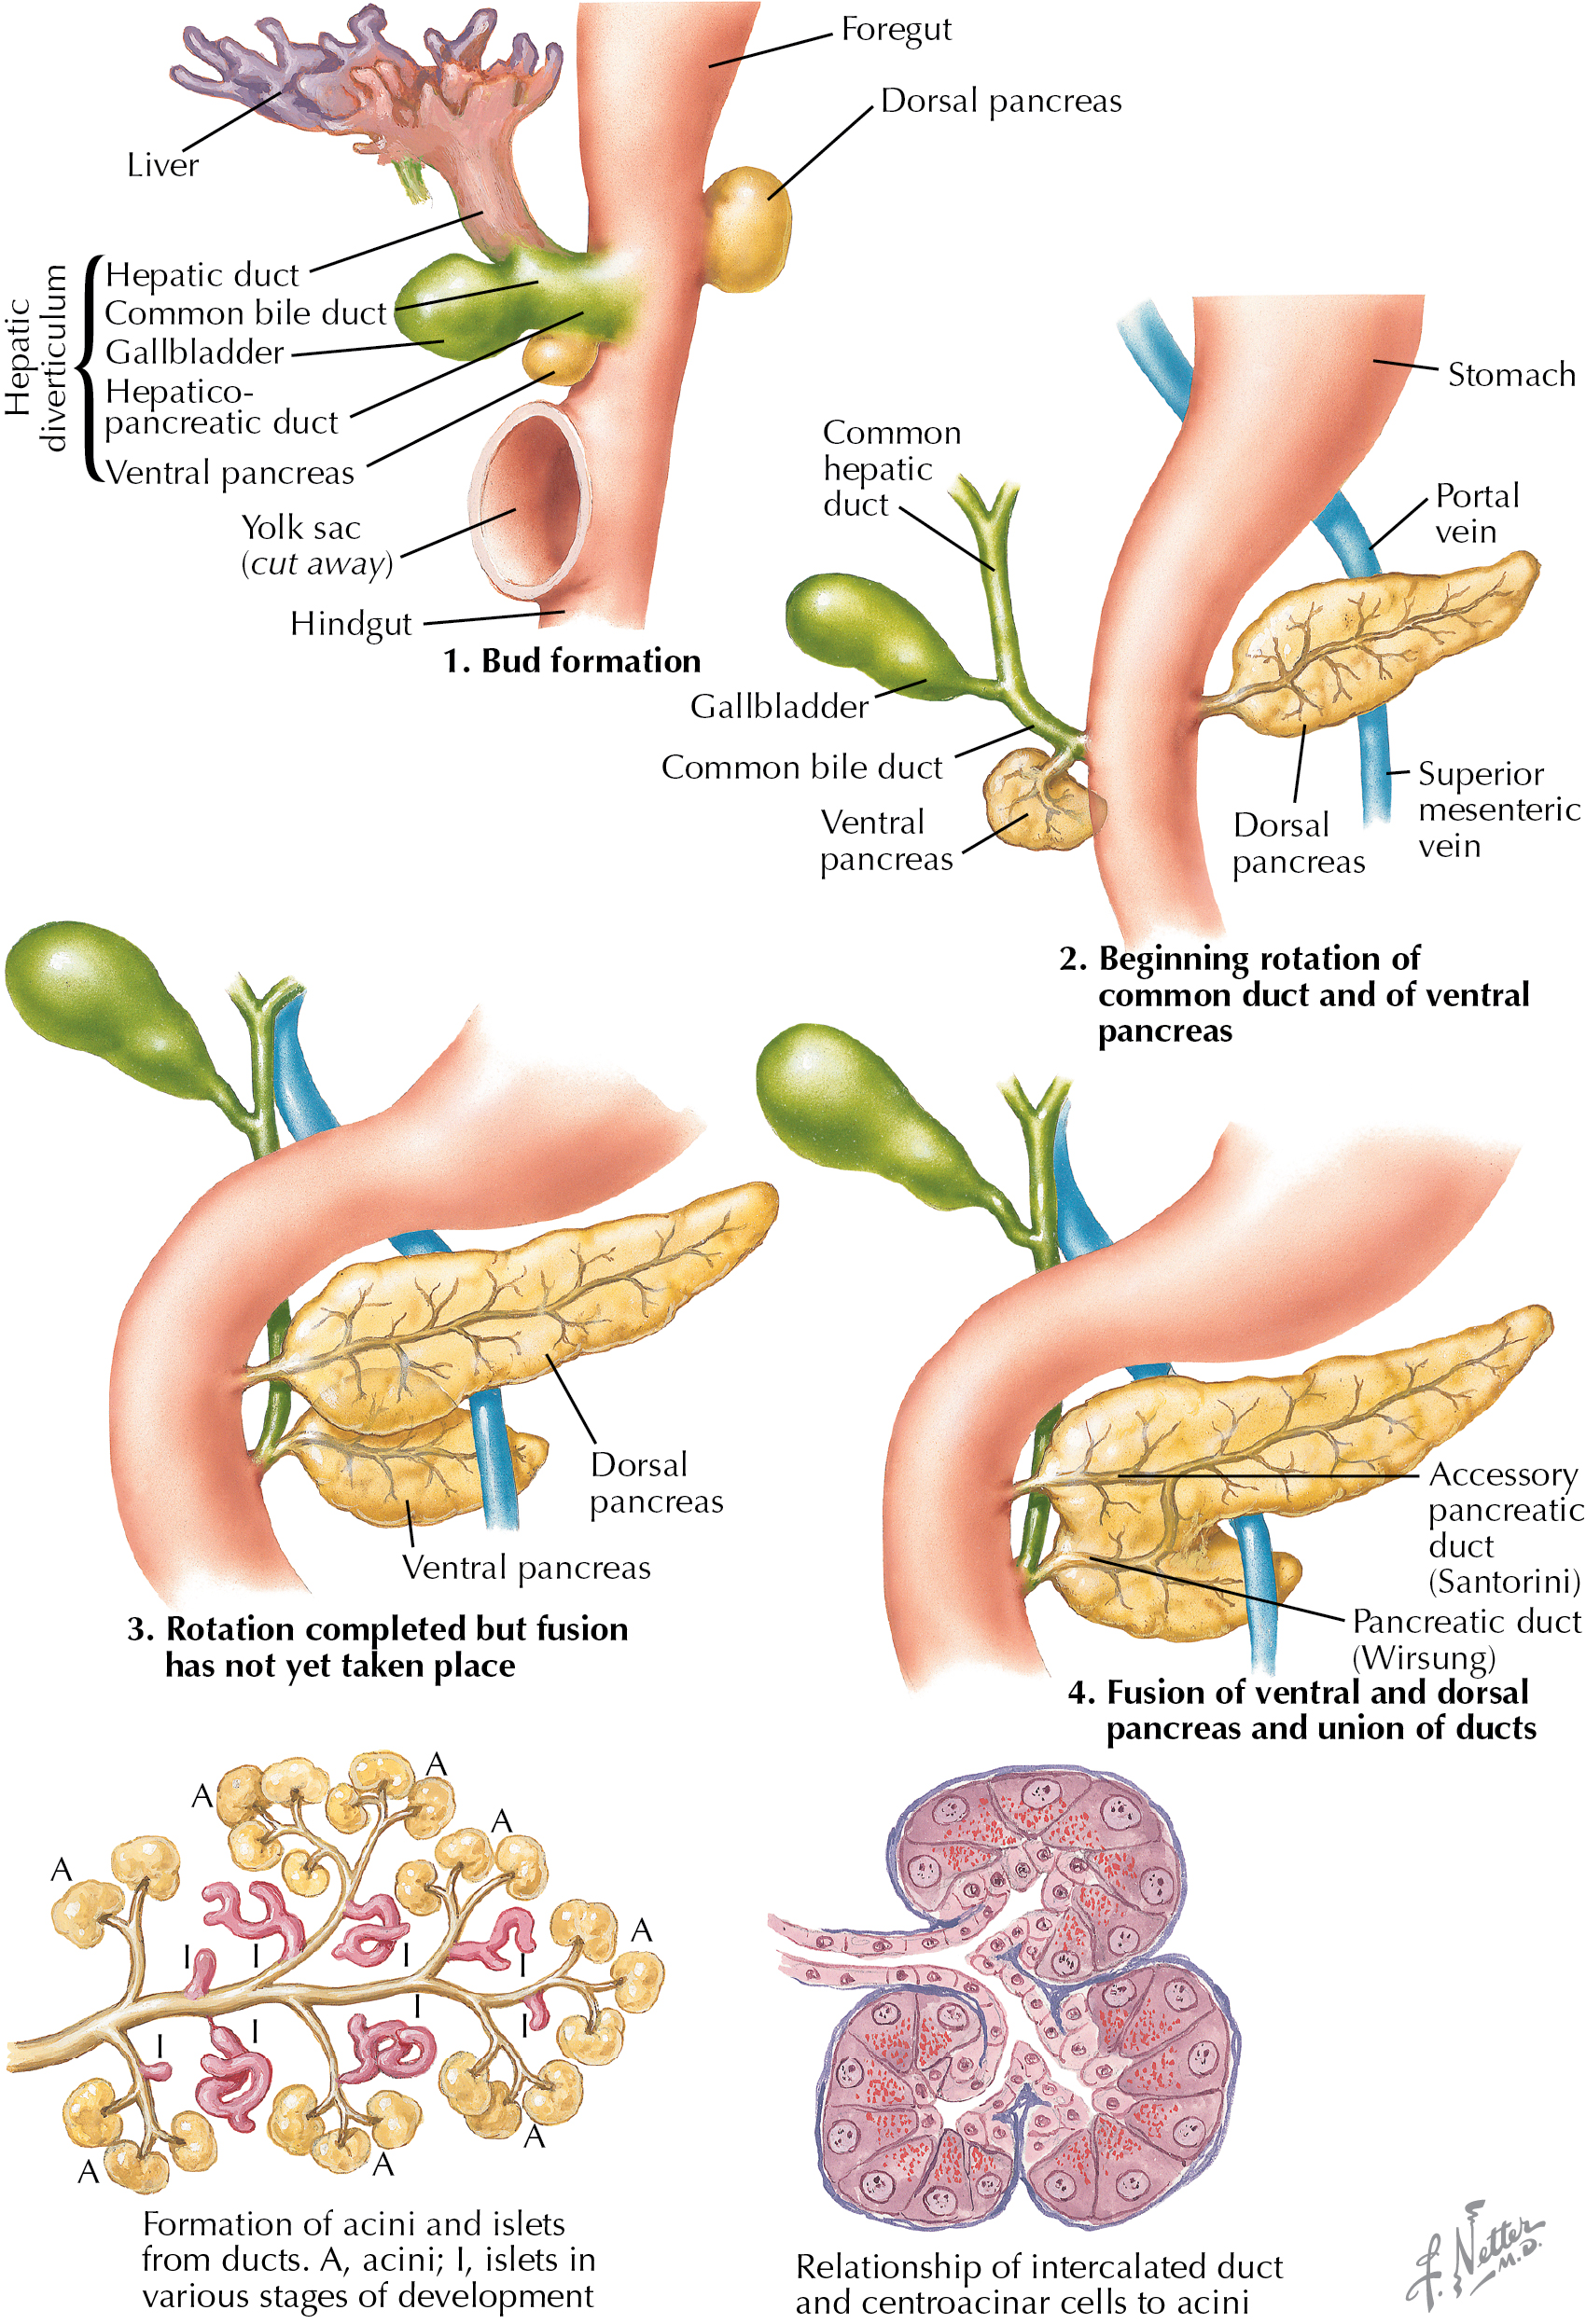
Pancreatic Development
1st month: Hepatic & 2 pancreatic buds (ventral, dorsal).
During clockwise foregut rotation in 2nd month, pancreatic buds fuse, drain into duodenum.
Notes:
Foregut is the first portion of what will eventually become the gastrointestinal tract, that give rise to 2 buds/diverticuli, the hepatic diverticulum (includes liver, gallbladder and ventral pancreas) and the dorsal pancreas.
The hepatic will give rise to the gallbladder, liver & the hepatobiliary tree.
There will be two pancreatic buds, one dorsal (larger), one ventral (smaller). During the 270 degree counterclockwise rotation of the foregut in the 2nd month, the two buds fuse, each with its own separate main ductal system for drainage, which will also merge (Ducts of Wirsung, and of Santorini).

Slide 7
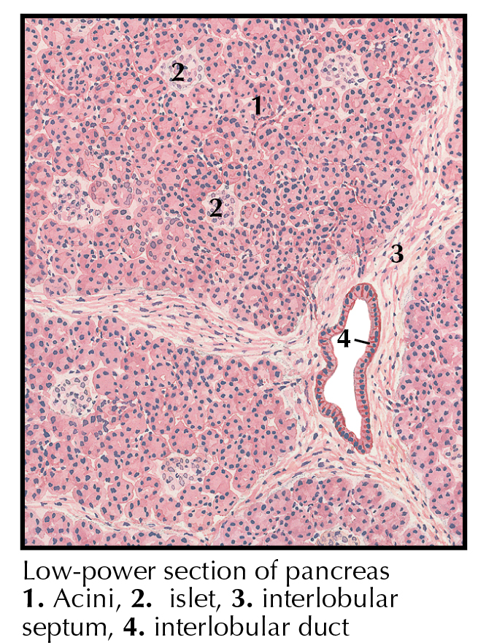
Pancreatic Development
Initially an intricate budding tubular system with central cavities, lined by secretory acinar cells.
Cells farther away from the tubules proliferate to create pancreatic islets (of Langerhans).
Notes:
So there are essentially two types of cells in the mature pancreas, depending on whether they used to be close to the pancreatic ductal system or not: These two different types of cells are responsible for the two main pancreatic functions: digestion and glucose control

Slide 8
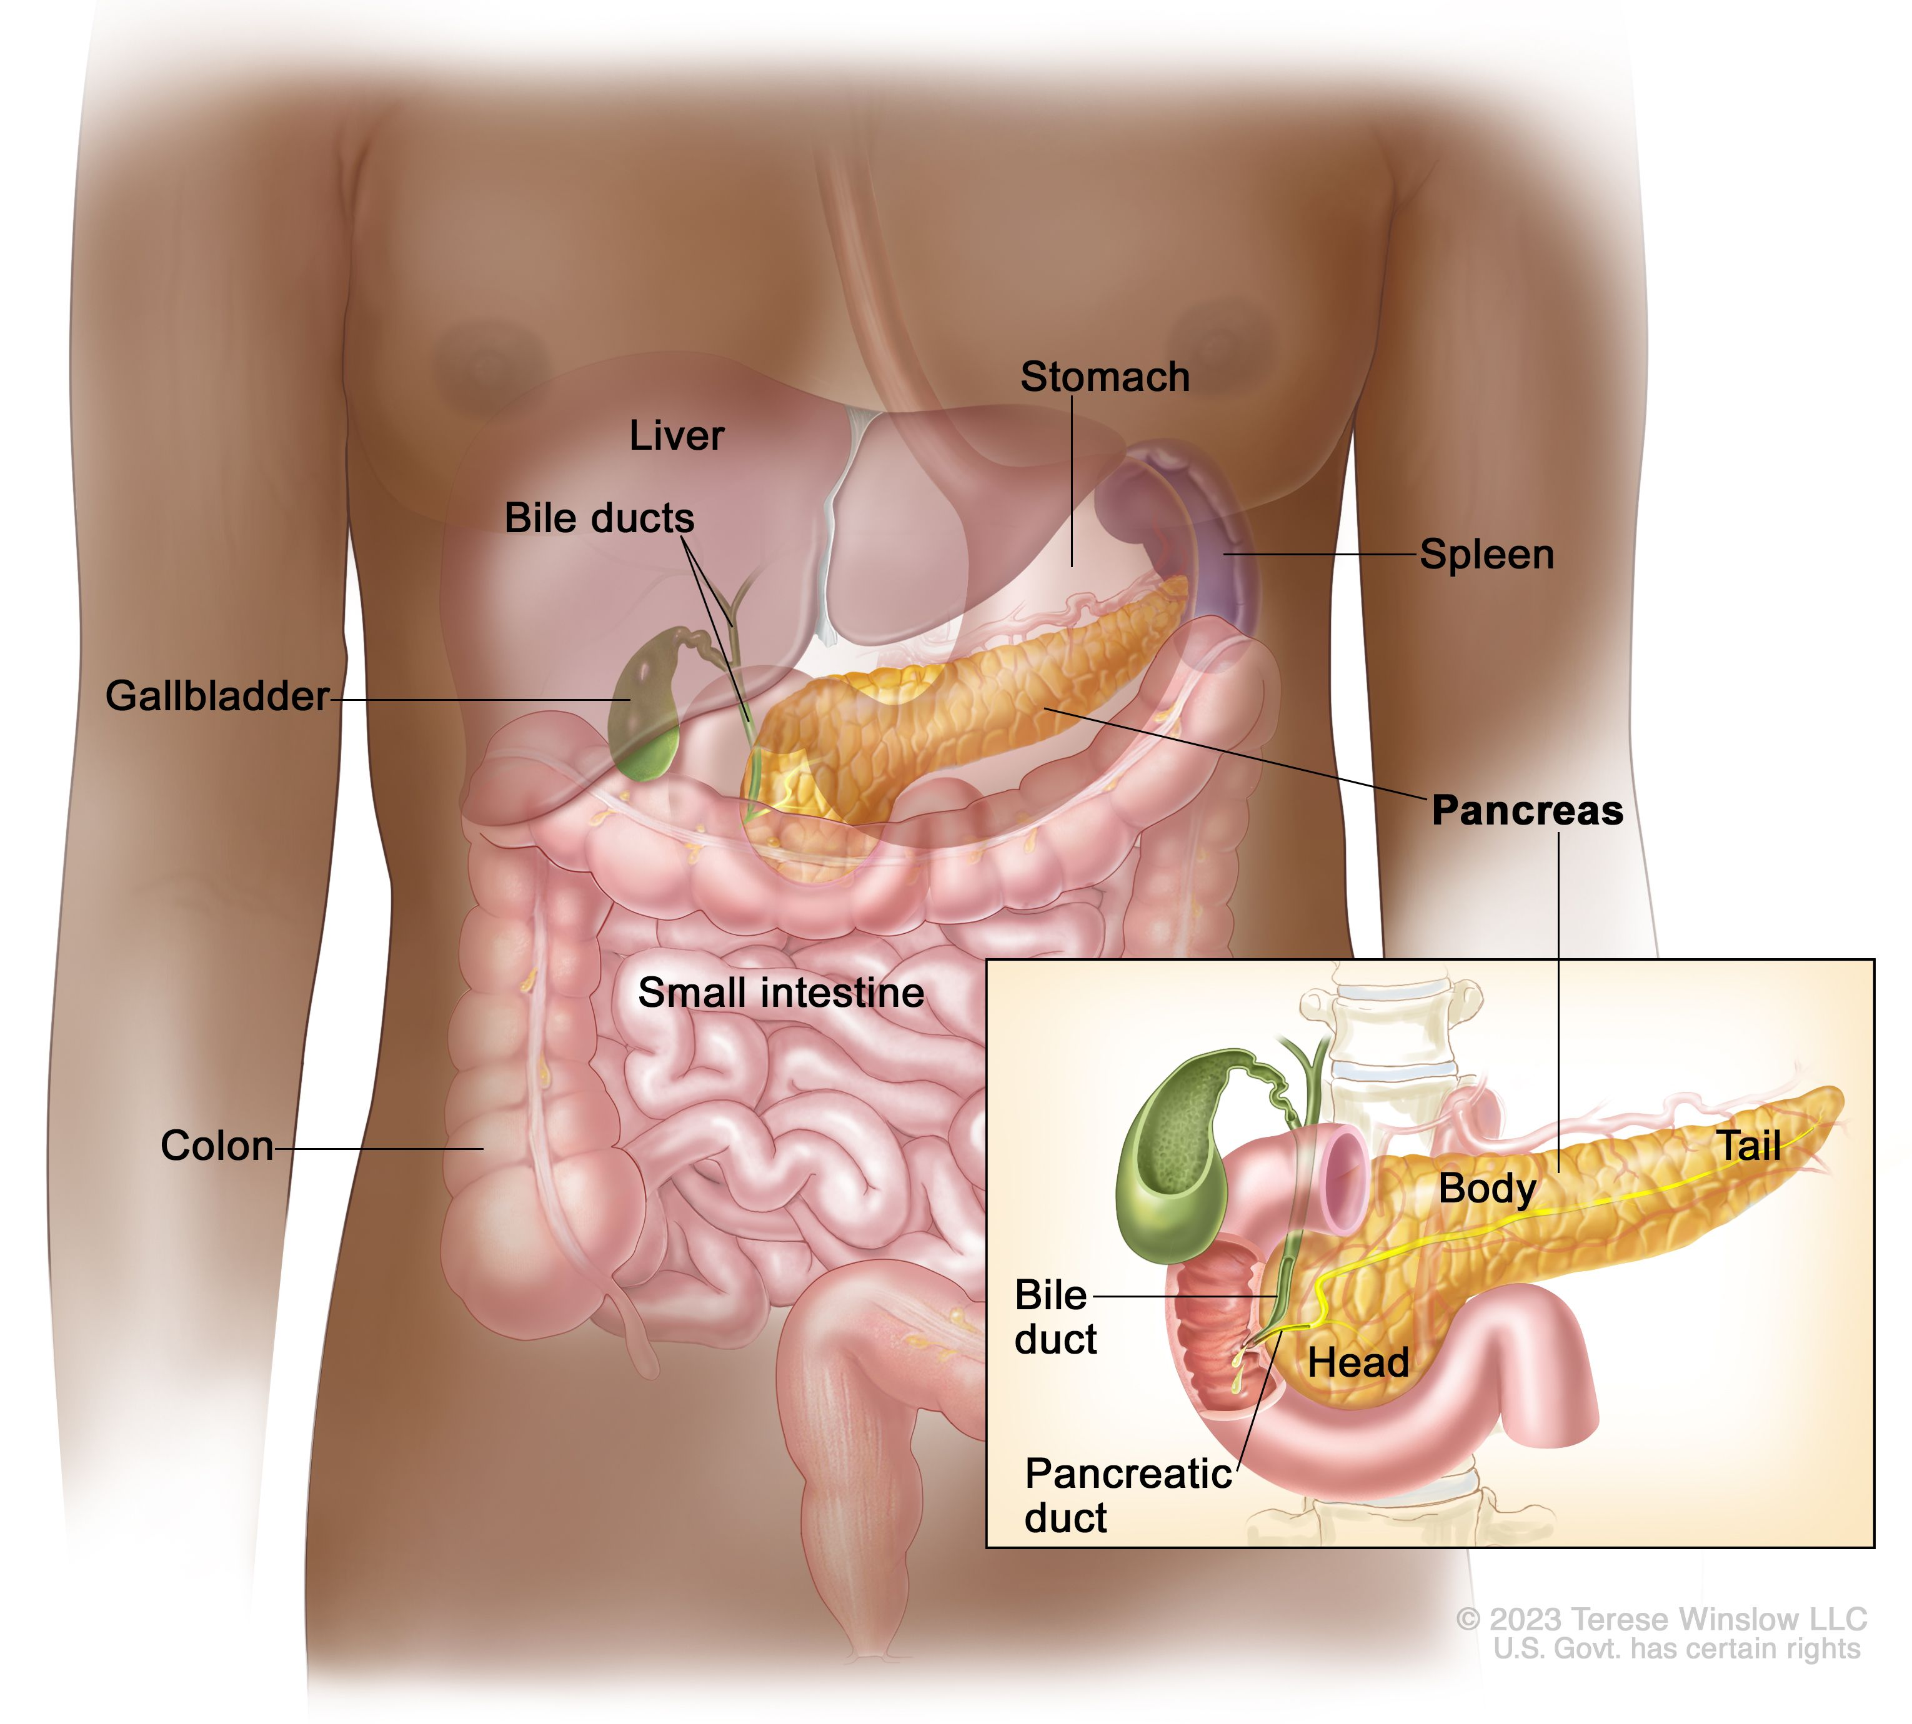
Pancreatic Function & Anatomy
Exocrine & Endocrine roles.
Large retroperitoneal gland, close to stomach, duodenum, liver.
Drains with liver in ampulla of Vater, in 2nd portion of duodenum.
Notes:
A lot more cells and functions, beyond the scope of current discussion.
Close to stomach & duodenum, due to initiation as two buds from the foregut (which eventually became the stomach & duodenum), and the liver – same drainage into ampulla of Vater (in the 2nd portion of the duodenum).

Slide 9
Pancreatic Function
Exocrine (Tubular System -> GI tract) | Endocrine (Bloodstream)
Acinar cells: Digestive enzymes (zymogens) | Insulin
Ductal cells: Cl, HCO3 | Glucagon
 | Pancreatic Polypeptide
 | Somatostatin
Notes:
Digestive enzymes in a precursor form, called zymogens.
Ductal cells produce HCO3, which forms pancreatic juice, which flushes digestive enzymes into from smaller ducts to larger -> GI tract.

Slide 10
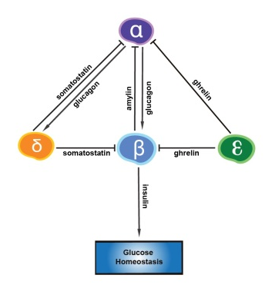
Endocrine Function – Glucose homeostasis
Endocrine pancreatic cells: α, β, δ, ε
  <5% of pancreas
β-cells release Insulin as a response to plasma Glu
  Glu enters β-cells -> ATP increase -> Ca++ influx -> Insulin secretion
DM1: Autoimmune destruction of pancreatic islets, leading to Insulin deficiency
DM2: Decline in β-cell function
Notes:
Amylin from beta cells (increases in feeding state), targets alpha cells, leads to glucagon secretion from alpha cells.
Glucagon (from alpha cells), as a response to peptides in duodenum, targets liver cells, enhancing glycogenolysis & gluconeogenesis. Promotes oxidation of fat (ketone bodies)
Somatostatin (from delta cells) from glucagon secretion, inhibits secretion of multiple hormones, including GH, Ins, glucagon, VIP, TSH.
Ghrelin (from epsilon cells) inhibits insulin secretion, stimulates appetite and GH secretion.

Slide 11
Hyperglycemia in Critical Illness
Hyperglycemia* in common in critical illness
  Diabetics: 93.7%
  Non-diabetics: 75%
Endocrine Pancreatic Insufficiency (EnPI): 80%
Increased mortality
Benefits of Glu control in critical illness:
  Fewer infections
  Less kidney failure
  Improved survival
Shebiny et al, J Anesthesia, 2021
Saberi et al, JPEN 2008
Inzucchi et all, NEJM 2006
Capes et al, Lancet 2000
Gale et al, Am Surg 2007
* Only partly due to Pancreatic Endocrine Insufficiency - EnPI
Notes:
Biggest contributor to hyperglycemia is the cortisol release which leads to gluconeogenesis.

Slide 12
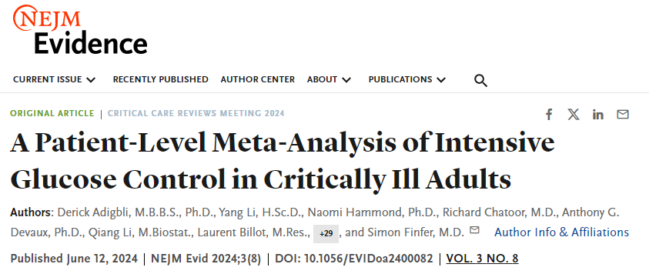
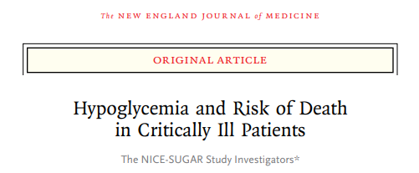
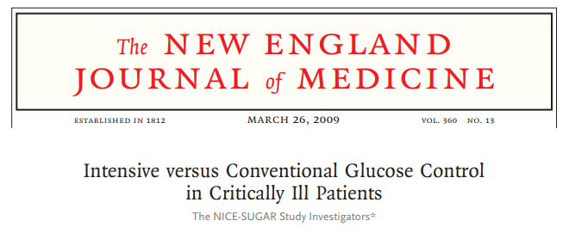
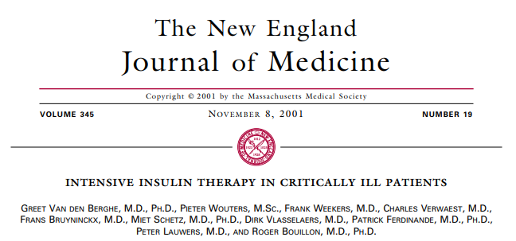
Hyperglycemia in Critical Illness
Notes:
Many studies have looked into association of hyperglycemia and critical illness outcomes with a variety of findings

Slide 13
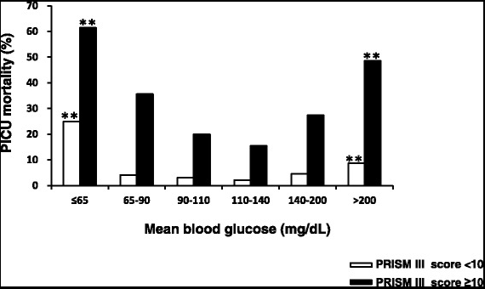
Hyperglycemia in Critical Illness
Li et al. BMC Pediatr, 2015
Notes:
They all seem to demonstrate that normoglycemia is associated with the best possible outcomes in this U-shaped mortality against Glu levels in a Peds ICU.

Slide 14
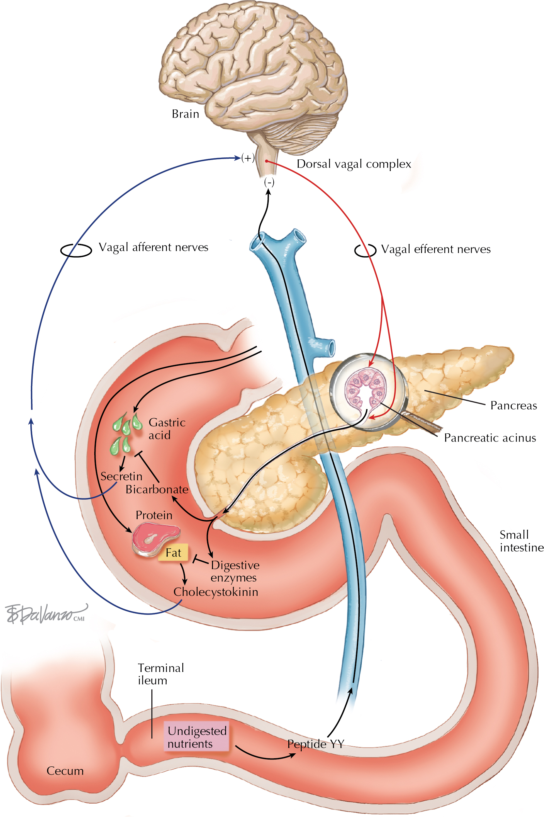
Exocrine Stimulation
Vagus innervates pancreas – sight/smell of food.
Vagus stimulates pancreatic ganglia (nerve cell complexes) -> Ach -> Ca++ messenger -> release of zymogens.

Slide 15
Exocrine Stimulation
Gastric distention, nutrients in Duo.
  Duodenum is the main sensory organ & activator of pancreatic exocrine secretion.
Gastric HCl -> Secretin
Protein/fat in Duo -> CCK
Undigested nutrients in terminal ileum -> Peptide YY
Notes:
Secretin afferent through vagus.
CCK afferent through vagus.
Peptide YY afferent through the blood stream.

Slide 16
Pancreatic Zymogens
Zymogens
Trypsin
Chymotrypsin A, B, C
Carboxypeptidase A1, A2, B1, B2
Elastase
Lipases* (lipase, co-lipase, lipase-related protein, phospholipase A2)
Amylase*
All zymogens are released in precursor form in Duo, are activated by trypsin.
* except lipase, amylase.
Excess trypsin activation, leads to autodigestion of pancreas -> acute panc.
Measurement of elastase in stool, amylase/lipase in bloodstream: measure of exocrine pancreatic function.
Notes:
Digestive enzymes in a precursor form, called zymogens.
Ductal cells produce HCO3, which forms pancreatic juice, which flushes digestive enzymes into from smaller ducts to larger -> GI tract.

Slide 17
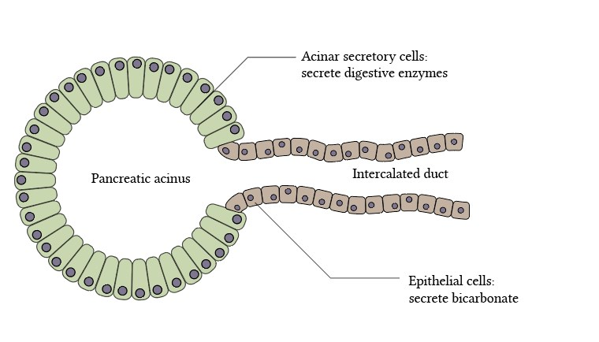
Pancreatic Ductal Secretion
Cl, HCO3 secreted from ductal cells through CFTR after stimulation with:
  Trypsin
  Secretin
  Hypercalcemia
  Danger signals
Notes:
CFTR: Cystic Fibrosis Transmembrane Regulator

Slide 18
Pancreas in Macronutrient Absorption
Carbohydrates / Protein: amylase & proteases from salivary glands and gastric mucosa.
  Near-normal absorption in EPI.
Fat: Pancreatic lipase responsible for 40-70% of total TGL absorption.
  TGL lipolysis throughout GI tract, there is no functional redundance of pancreatic lipase.
  Long chain FA most affected.
  Fat absorption severely affected in EPI.
Lindkvist et al. World J Gastroenterol, 2013
Keller et al. Gut, 2005
Fieker et al. Clin Exp Gastroenterol, 2011

Slide 19
B. Fat Absorption

Slide 20
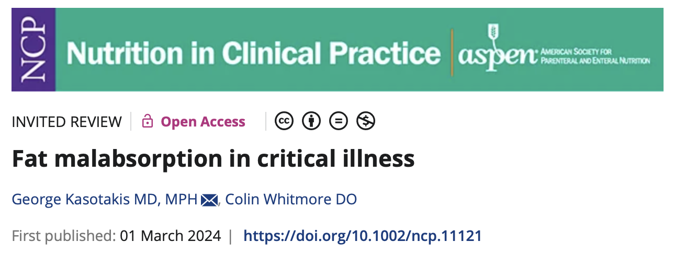
Normal Fat Digestion & Absorption
Pancreas is key!!!
  Protein & carbs may also be digested with a severely affected pancreas.
Fat: 2nd most common energy fuel for human body
  35-45% of daily caloric expenditure
  1 gm fat oxidized ➔ 9 Kcal of energy
Notes:
Pancreas plays an important role in digestion of all 3 macronutrients – but protein & carbohydrate digestion and absorption far less affected by intact.
Carbohydrates also require normal pancreatic function.

Slide 21
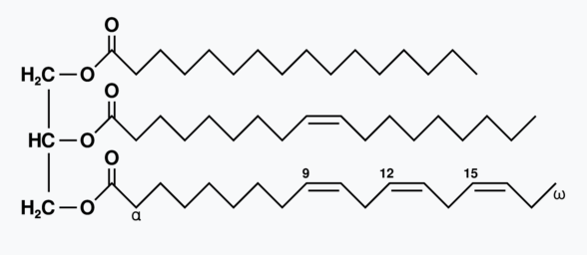
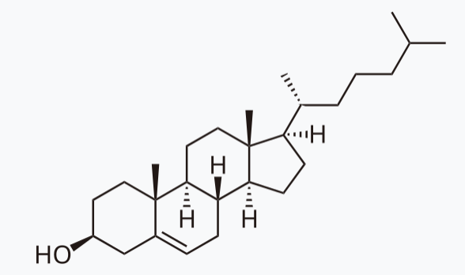
Dietary Fat
Triglycerides (TGL)
Cholesterol (Chol)
Glycerol + 3 Fatty Acids (FA) (long, medium, or short chain)
Cell wall homeostasis
Fat-soluble nutrient transport
Immediate energy source
Energy storage in body fat
Sterol nucleus
Broken down by bile salts
Energy source
Cell wall component
Synthesis for steroid hormones, bile, Vit D
Notes:
Cholesterol requires little involvement of the pancreas for absorption.
Broken down by bile salts (produced by liver & stored in the gallbladder), converted to micelles.

Slide 22
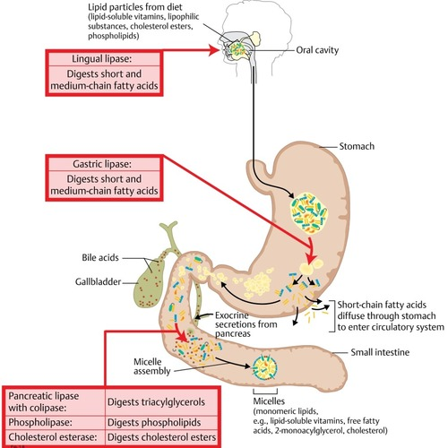
Normal Fat Digestion & Absorption
Fat hydrolysis starts in mouth & stomach.
90% of fat hydrolysis takes place with pancreatic lipases in proximal small intestine.
Cholesterol broken down by bile salts
Release of fatty acids:
  Long-chain (fat-soluble): packaged into chylomicrons, transport into lymphatic system, fat
    Main energy storage (multiple high-energy bonds)
    Essential: Linoleic, linolenic only in diet
  Medium, short-chain (water-soluble): absorbed directly into portal circulation
    SCFA: energy source for colonocytes
Notes:
So we mentioned that carbohydrates, proteins and now medium & short chain FA may be absorbed without significant contribution from the pancreas, it is the long

Slide 23
Pancreatic Effect on Digestion
Carbs, protein, cholesterol, short & medium chain FA may be absorbed with little contribution from the pancreas.
Long chain FA absorption, lipid-soluble compounds most affected by EPI.
Notes:
Pancreas plays an important role in digestion of all 3 macronutrients – but protein & carbohydrate digestion and absorption far less affected by intact.
Carbohydrates also require normal pancreatic function.

Slide 24
C. Exocrine Pancreatic Insufficiency (EPI) / Cystic Fibrosis (CF)

Slide 25
Cystic Fibrosis / Exocrine Pancreatic Insufficiency (EPI)
Low Cl, HCO3 secretion
Low fluid secretion
Thick, dehydrated plugs
Pancreatic ductal occlusion
Exocrine dysfunction
Mutation of CFTR channel that limits Cl, HCO3 secretion
Inability to absorb fat, diarrhea, abdominal pain, distention, Vitamin deficiencies, failure to thrive.
Tx: Pancreatic Enzyme Replacement Therapy (PERT), ADEK Vitamins, frequent small meals, nightly TF supplementation.
  PERT: Before meals, noc TF – works for 45-60’
  No TF formula contains predigested TGLs (oxidation, not shelf stable)
Ramalho et al. Curr Diab Rep, 2020
Karpinska et al. Front Physiol, 2022
Notes:
TF supplementation if pts experience growth arrest (but of course will require PERT, right before which will only cover the first hour at night)

Slide 26
EPI in CF
CF is associated with:
  EPI
  Reduced caloric intake
  Inability to maintain weight
  Fat malabsorption
  GI symptoms
90% of CF have EPI, need Pancreatic Enzyme Replacement Therapy (PERT).
  PERT: Includes lipase, amylases, proteases
44% require oral enteral nutrition supplementation.
10-12% of CF require supplemental TF at night for caloric support.
Notes:
This information was about EPI in critical illness, where little is known.
However, it is a far more common clinical entity in patients with CF, also chronic pancreatitis, pancreatic cancer, pancreatectomies, etc.
PERT includes all 3 enzyme types, but titration happens based on lipase & fat malabsorption.

Slide 27
EPI in CF
40-70% of fat in polymeric & semielemental formulas is in medium-chain forms, partially eliminating need for pancreatic lipase for absorption.
Essential FA Linoleic & linolenic require pancreatic lipase for absorption.
Linolenic: precursor to omega-3 FA, including DHEA, EPA.
  Important factors for inflammation, cell wall membrane stability.

Slide 28
PERT in CF EPI?
PERT is FDA approved for CF-associated EPI with oral diet.
  Enteric coated PERT microspheres dissolve at ph>5.5 to protect enzymatic activity until they are past the stomach and into the duo.
  CF may have increased gastric acid secretion, decreased pancreatic HCO3 secretion, potentially rendering PERT ineffective.
    Commonly co-administered with NaHCO3, H2RA, PPI therapy.
PERT not approved for TF nutrition.*
  If crushed, enzymes may become inactivated in the gastric acidic environment.
  Crushing is against manufacturers recommendations – obstruction of feeding tube.
  For enteral, non-oral nutrition exogenous lipase is required.
Berry et al. Nutr Clin Pract 2014
Struyvenberg et al, BMC Med 2017
* Although widely used
Notes:
We know PERT is the treatment for EPI patient who tolerate oral diets.
What about those who require TF?

Slide 29
EPI response to treatment
Markers of fat absorption:
  Omega 6/3 ratio, DHEA, EPA plasma levels; Erythrocyte DHEA, EPA
    Sensitive & specific, but expensive
  72h stool fat
    Sensitive, but cumbersome
    May be false negative if significant secretory diarrhea (dilution)
  Sx: Nutrition tolerance, improvement of abdominal symptoms, weight gain
    Most commonly used
Notes:
How do we assess response to treatment when we initiate it?

Slide 30
ILC: Immobilized Lipase Cartridge
External pancreatic lipase cartridges, in line with enteral nutrition (TF)
  Pancreatic lipase covalently-bound to & immobilized on biochemically inert beads.
  When TF flow through it, lipase hydrolyzes fats to FA, monoglycerides that are easy to absorb mimicking intestinal function.
  Hydrolyzes 90% of fat in TF formulas.
Increases fat absorption, weight & improves feeding intolerance in pts with CF^{1, 2}
Hendrix et al. Nutr Clin Practice, 2022
Stevens et al, J Pediatr Gastroenterol Nutr 2018

Slide 31
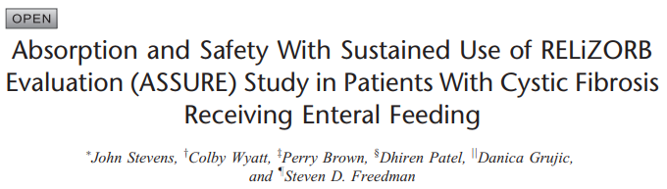
ASSURE Trial - 2018
Prospective, multicenter, single arm, open label trial
Patients: CF and documented EPI, on PERT, & TF at night for supplementation
Immobilized Lipase Cartridges in line with TF
Outcomes:
  Omega-3 levels
  Docosahexanoic acid (DHEA), Eicosapentanoic acid (EPA) in RBCs, plasma
  GI symptoms
  Exploratory outcomes: Vits A, D, E, K; albumin; prelab; transferrin; wt; BMI

Slide 32
ASSURE Trial – Study Design
Pre-study
TF (Peptamen 1.5) with PERT supplements for both po diet & TF.
Study
Open label TF (Impact Peptide 1.5) and ILC. With PERT for po diet, no PERT at night.
Symptom documentation
DHEA, EPA levels
Omega 3
Symptom documentation
DHEA, EPA levels
Omega 3
Total of 90 days
Notes:
Switched everyone to Peptamen for homogeneity.
Peptamen 1.5: Semielemental formula with 70% medium chain TGLs, 30% long chain. Selected this so all subjects would receive the same TF.
Impact Peptide 1.5: Similar but with 50% - 50% medium and long chain FA.
Unsure why they

Slide 33
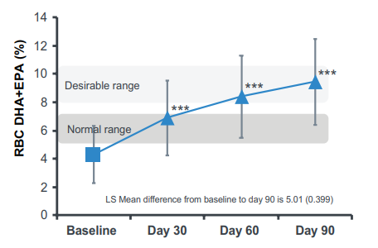
ASSURE Trial - 2018
N = 39
  Age: 13.8 + 5.4
  Males: 62%
  Weight (kg): 40.8
  BMI: 17.7
Omega-3 increased
DHEA, EPA increased (plasma & RBC)
Abdominal pain, diarrhea, gas, nausea, vomiting all improved
Vits A, D, E, K; albumin; prelab; transferrin; wt; BMI: No statistical change
Notes:
Omega 3 & DHEA/EPA are long chain fatty acids with anti-inflammatory properties, the latter important for cell membranes of red cells.

Slide 34
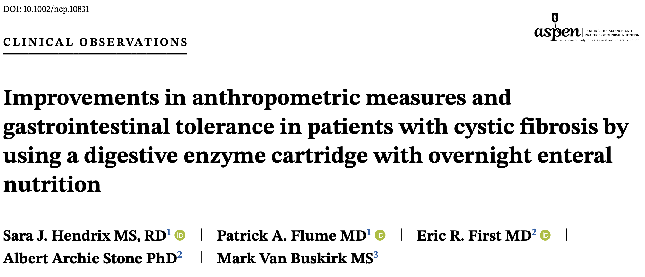
2022
Single-center retrospective chart review.
Patients: CF patients receiving nightly TF supplementation
Intervention: Initiation of ILC with nightly TF
Data collection: Demographics, anthropometrics, GI symptoms, formula type & volume, Vit D levels before and most recent while on ILC
Notes:
A group of investigators from MUSC, led by a Registered Dietitian, Mrs Hendrix.

Slide 35
Results:
N= | 18
Age (yrs) | 12.6 (9.5)
Male (%) | 67
TF duration before ILC (months) | 28 (32)
ILC duration (months) | 18 (10)
Indication for TF: Poor growth (%) | 72.2
Notes:
One patient dropped out because the ILC kept disconnecting at night setting off alarms.
A second died of terminal lung disease.
A third moved away.
The results here include these truncated patients.

Slide 36
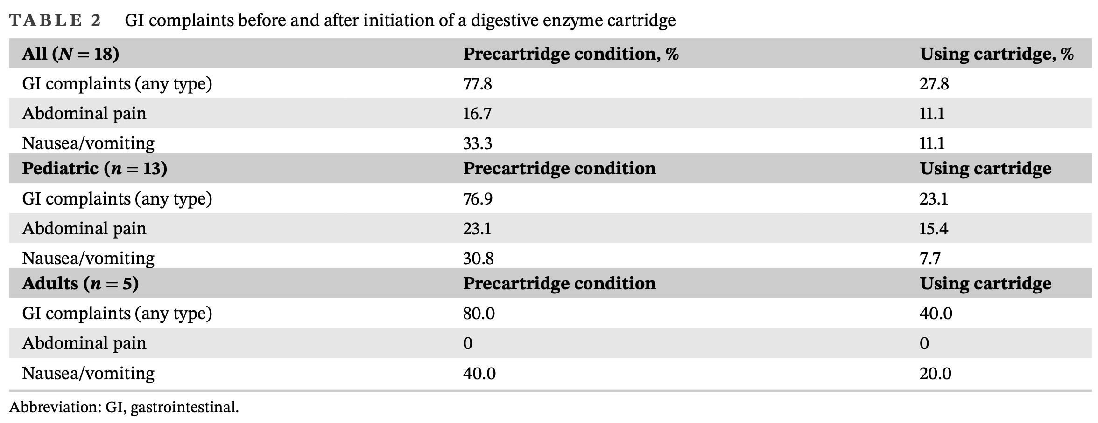
Notes:
A group of investigators from MUSC, led by a Registered Dietitian, Mrs Hendrix.

Slide 37
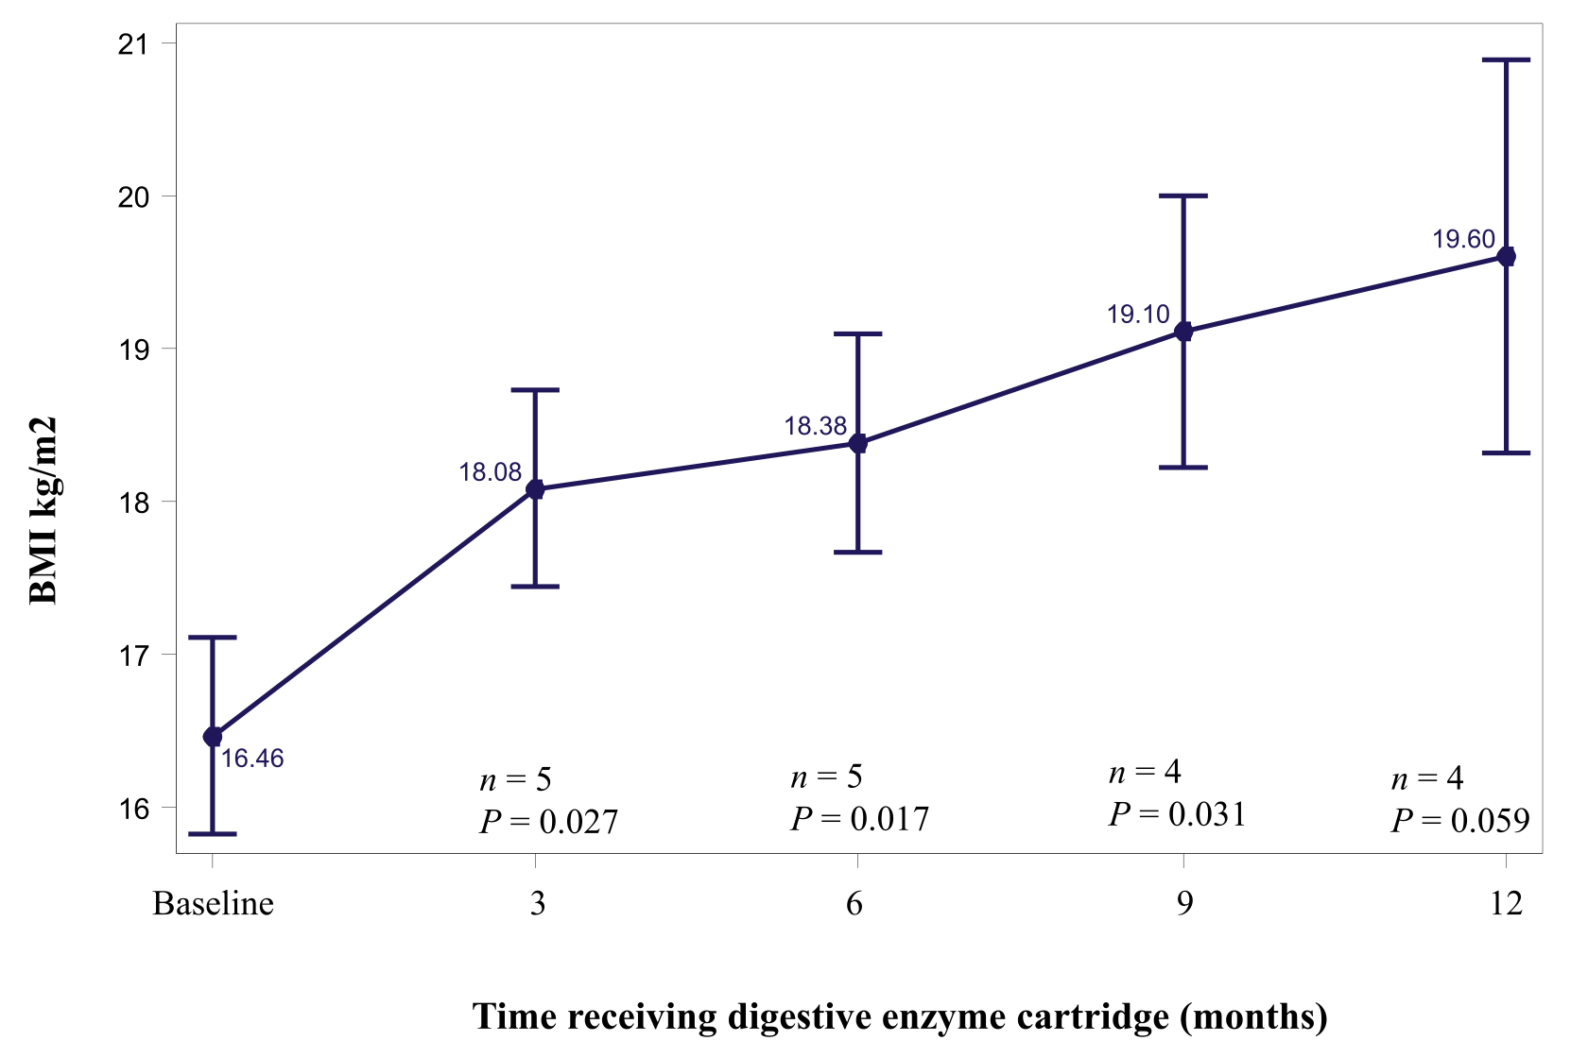

Slide 38
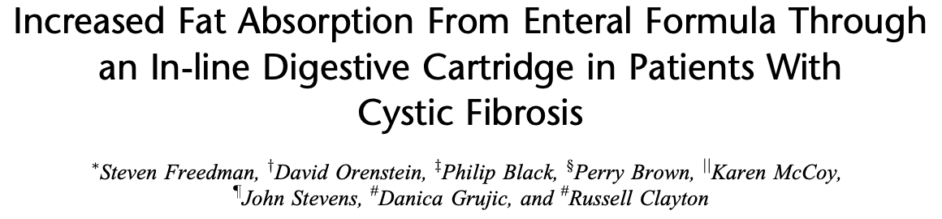
2017
Multicenter double-blind cross-over study
Patients: CF patients receiving TF supplementation
Intervention: Period A: 7d of Peptamen 1.5 qhs, routine PERT (home)
        Period B: Double blind cross-over clinic visit of Impact Peptide 0.5L in clinic with DHA, EPA levels x24h after intervention (ILC vs placebo)
        Period C: 7d open label Impact Peptide 1.5 qhs with ILC (home)
Data collection: Symptoms between 1 & C, DHEA, EPA levels in 2.
Notes:
A group of investigators from Beth Israel & Harvard in Boston

Slide 39
2017
N= | 33
Age (yrs) | 14.5 (6.2)
Male (%) | 60
BMI | 17.5
TF duration before ILC (yrs) | 6
Notes:
Out of 34 enrolled, 33 were analyzed, as one had to drop out due to pulmonary exacerbation.

Slide 40
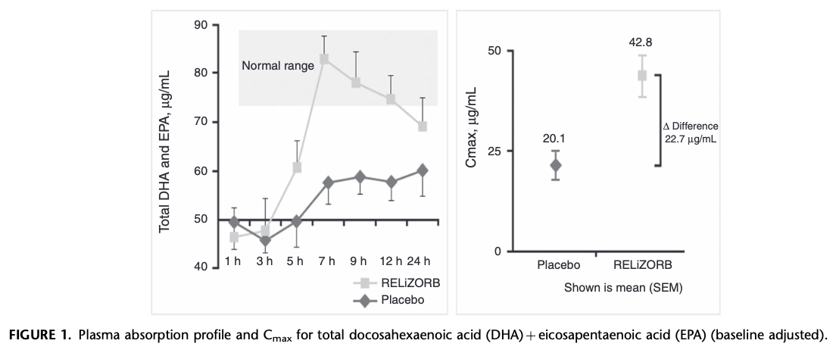
2017

Slide 41
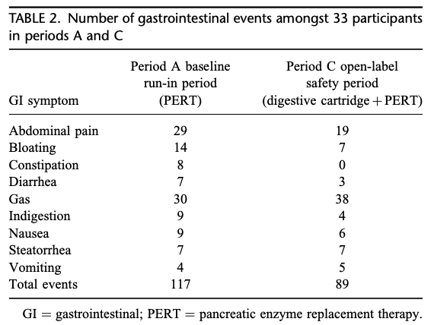
2017
Notes:
Comparing their GI symptoms between treatment at home before and after ILC - all GI symptoms improved except for flatulence.

Slide 42
Basic Science Experiments
Group of investigators from Beth-Israel, Harvard in Boston
Piglets underwent 75% intestinal resection, received central line, G-tube
7-day recovery -> TPN initiated, when tolerating at 100%, TF initiated at 20% of caloric needs, advanced every two days by 10% while TPN was reduced respectively, replaced by IVF
  In absence of liquid diarrhea (Bristol stool score 6-7) & wt gain >100 g/d
  No access to oral diet, water
  TF administered with ILC or placebo
Experiment duration 14 days
Datapoints (wt, lipids, lipid-sol vitamins) were examined at TF initiation & 14 days later
Notes:
Prolific group of authors that published 2 different manuscripts with slight variations in data points examined

Slide 43
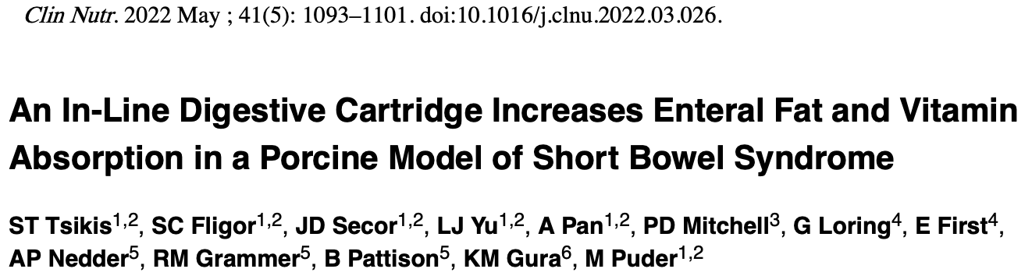
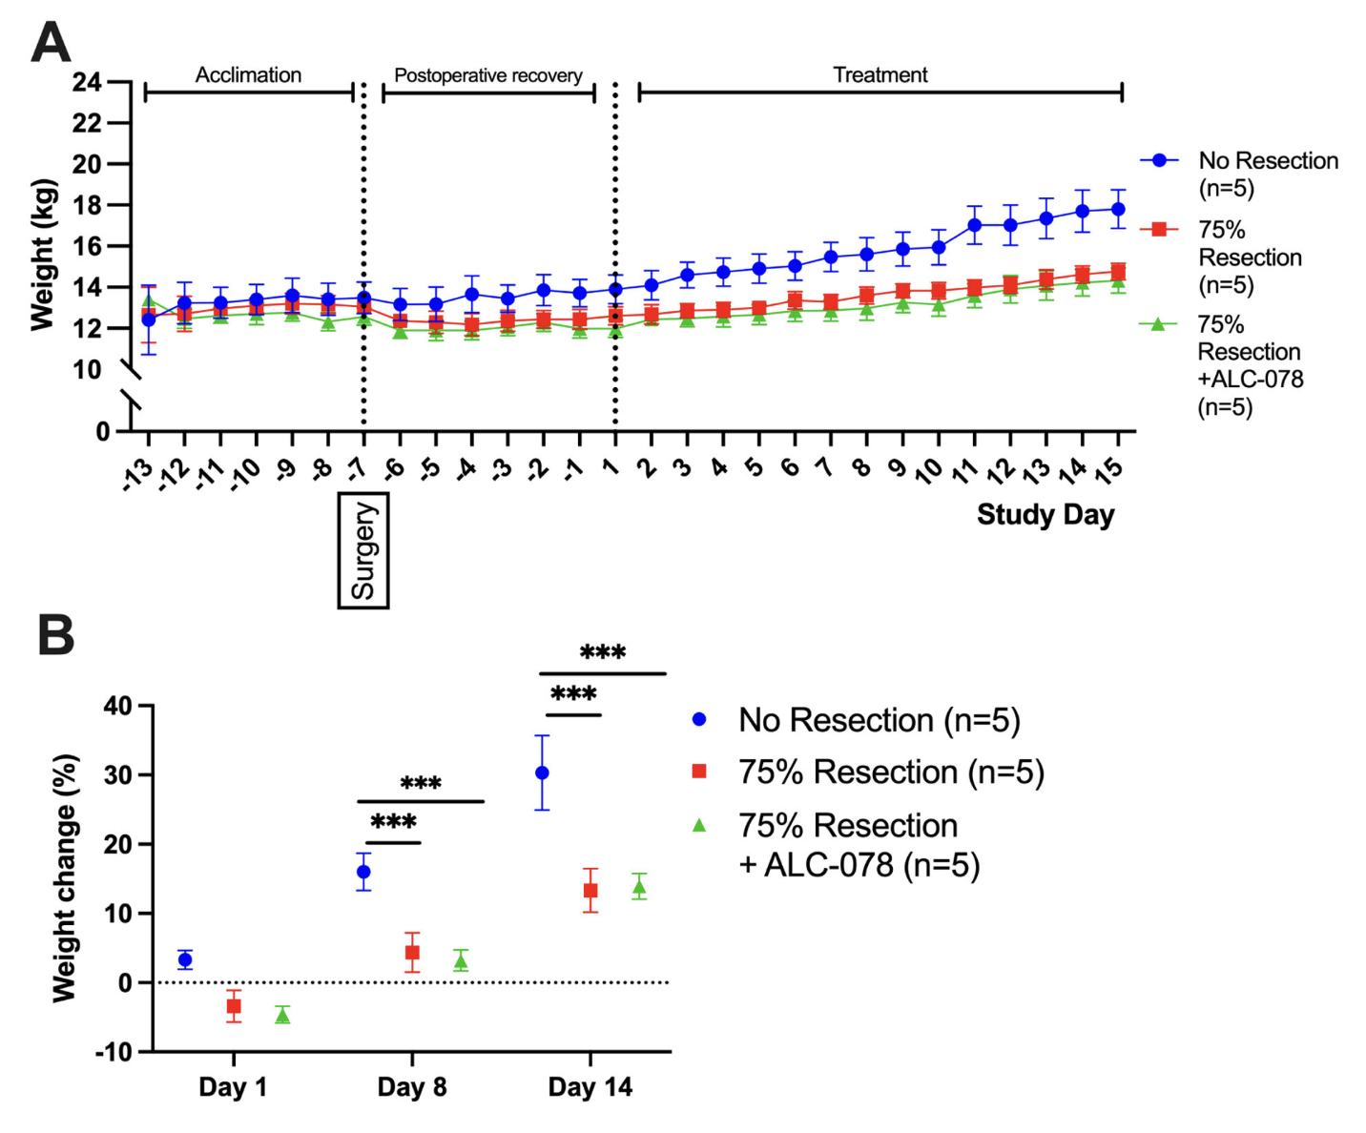
Notes:
They showed there was no statistical significance in weight gain at 2 weeks (it would be hard, given the short amount of time)

Slide 44
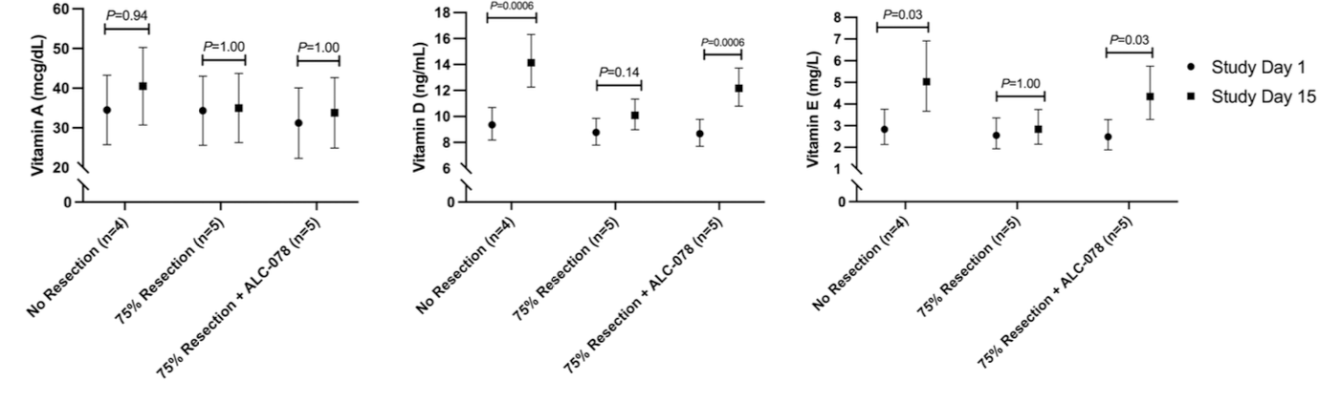
Notes:
…but demonstrated an improvement in Vit D & E levels in just these 2 weeks…

Slide 45
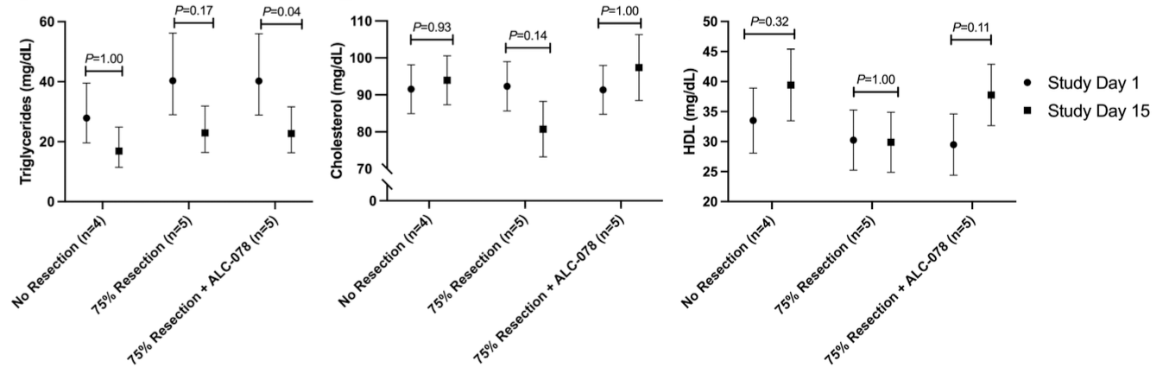
Notes:
No differences in the plasma lipid profile of these piglets

Slide 46
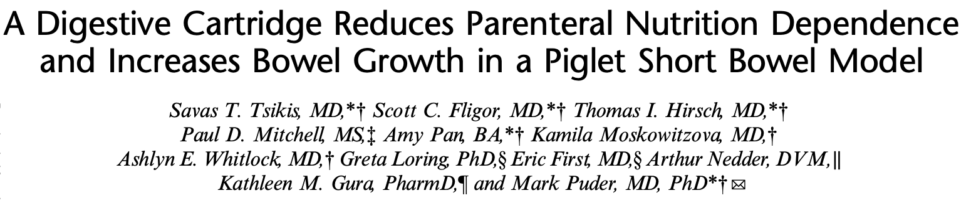
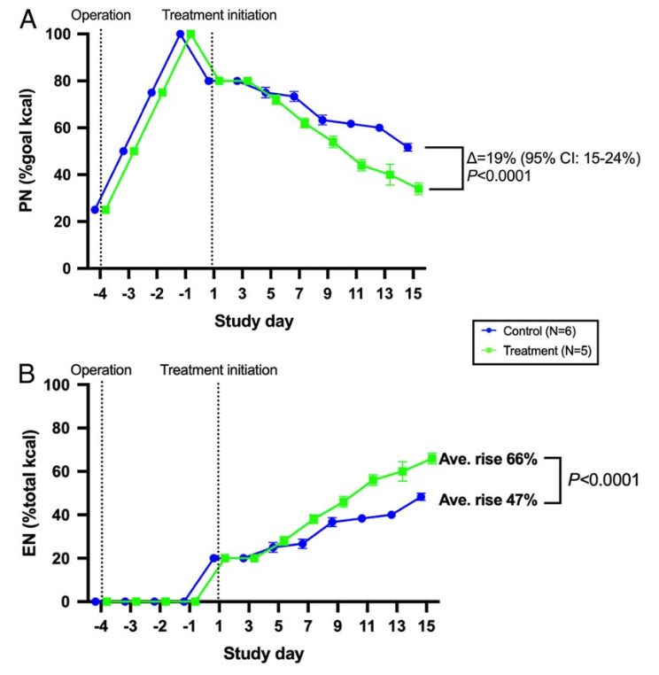
Notes:
On a separate manuscript they demonstrated that the % of calories required from TPN was lower if the animals had been administered the therapeutic cartridges, and conversely higher % of calories from enteral nutrition.

Slide 47
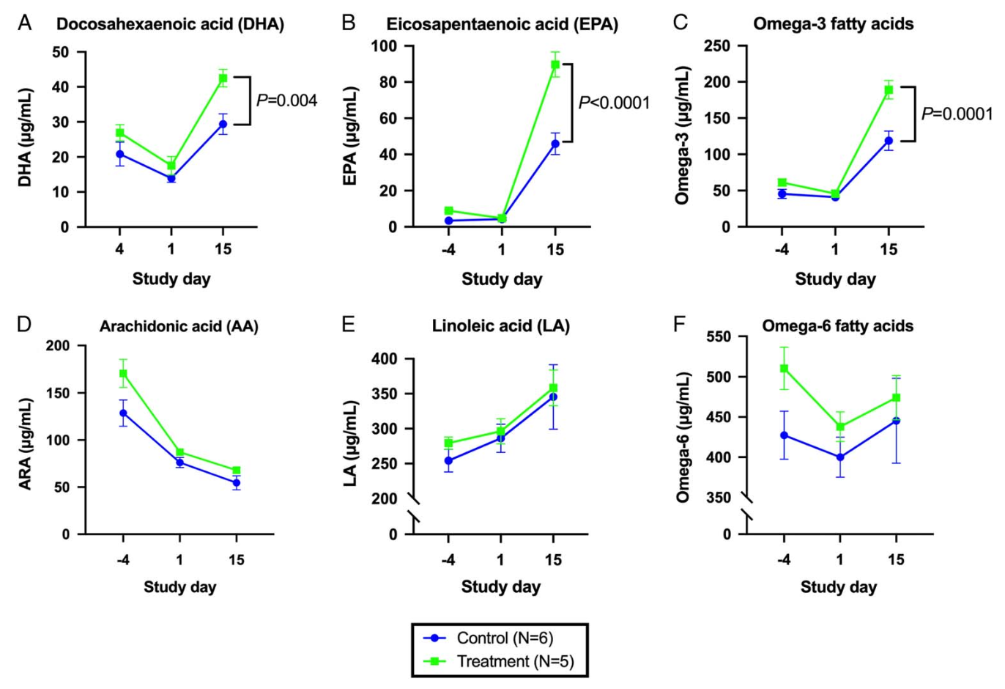
Notes:
DHA, EPA and omega-3 fatty acids were also higher at 2 weeks with treatment…

Slide 48
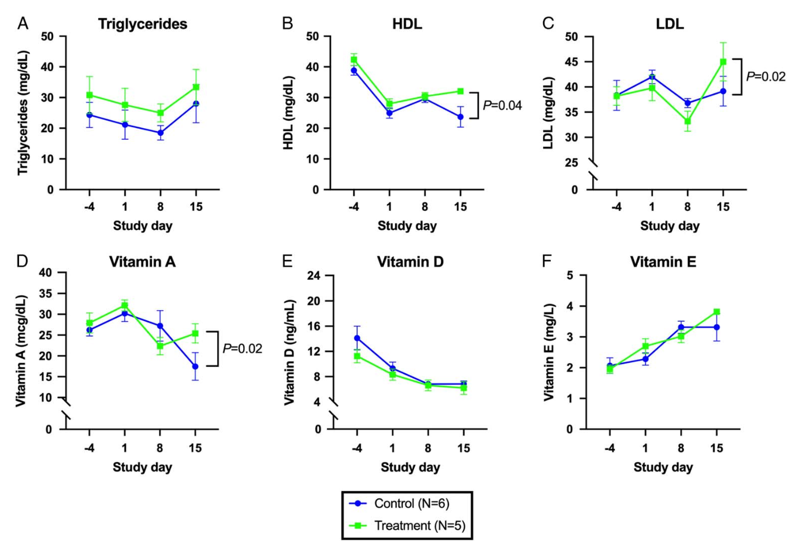
Notes:
HDL, LDL, Vit A (but not D or E) were higher in this second round of experiments 2 weeks after treatment initiation.

Slide 49
Notes:
HDL, LDL, Vit A (but not D or E) were higher in this second round of experiments 2 weeks after treatment initiation.

Slide 50

What about in critical illness?

Slide 51
D. EPI in Critical Illness

Slide 52
D. EPI in Critical Illness
Extremely common
Extremely undiagnosed

Slide 53
Fat Mobilization & Digestion in Critical Illness
Stress or injury
ACTH, cortisol, Glucagon, GH, Insulin reduction
HSL activation
FA mobilization, oxidation
Rapid depletion of fat storage¹
Stress or injury
Impaired fat absorption (30-50%)!
Delayed gastric emptying* or TF directly in stomach/duo
Ileus / lower propulsions limit chyme exposure to hydrolases & lipase
Prokinetic exposure lowers fat absorption**
Ischemic / hypoxemic insults to gut & pancreas decrease function of both
¹ Unaffected by Glu administration.
* Either in its own right, or by holding TF when gastric residuals rise
** Not only in critically ill, but also in healthy subjects who receive erythromycin experimentally
! Increases risk for infections, MOF, sepsis, death.
Souba et al. NEJM 1997
Huyhn et al. Diet Nutr Crit Care 2016
Abdelhamid et al. JPEN 2015
Notes:
1st arrow: increased fat mobilization from body stores

Slide 54
Fat Digestion & Absorption in Critical Illness
Fat malabsorption happens regardless & independent of carb & protein malnutrition.
Proportion of pancreatic-dependent lipolysis vs intestinal absorption unclear.
Liver capable of lipogenesis (synthesizing TGL) from amino acids, carbs, but dietary intake remains chief source of TGLs and essential FA.
Kasotakis et al. Nutr Clin Practice 2024
Marin et al. Am J Physiol 1992
Notes:
So we have both increased fat mobilization & turn over during critical illness, and decreased absorption.

Slide 55
Hypermetabolic state
sepsis
trauma
major surgery
MOF
Severe infections
Underfeeding:
* Late enteral initiation
* Pauses for interventions
* ‘Feeding Intolerance’
ileus
abdominal distention
diarrhea
Malnutrition
Increased infections
Longer ICU/Hospital stays
Increased mortality (?)
Notes:
However, even though nutrition is as important as every during critical illness, a hypermetabolic state due to catecholamine release.

Slide 56
EPI etiology in critical illness
Likely multifactorial
Relative pancreatic ischemia in septic shock seemingly primary
Pancreas very sensitive to minor circulatory changes
  Pancreatic changes noted before Cr rises
Chaari et al. World J Gastrointest Onc 2016
Dams et al. J Clin Med 2022

Slide 57
Incidence of EPI in critical illness
Wang et al: n=500 critically ill pts
Measured fecal elastase, serum amylase/lipase 3-5d after TF initiation
EPI: Fecal elastase <200 mcg/g
52% incidence of EPI in critical illness
  More common than hyperamylasemia, hyperlipasemia
Wang et al. Crit Care 2013

Slide 58
EPI clinical presentation in critical illness
Presentation just like ‘feeding intolerance’.
  Ileus, elevated gastric residuals
  Cramping
  Abdominal distention
  Steatorrhea
  Diarrhea
Both likely present / overlap, as ischemia affects both intestinal mucosa & pancreas alike.
Commonly managed with addition of prokinetics, change in formula, bulking agents.
Kasotakis et al. Nutr Clin Practice 2024
Notes:
How do you know when a patient in the ICU has feeding intolerance due to EPI vs intestinal insufficiency? We don’t – those are likely present concurrently, and should be managed concurrently.

Slide 59
EPI diagnosis
Measurement of fecal elastase: <200 mcg/g
  Sensitive enough for moderate, severe EPI
  Inadequate for mild EPI
  May be falsely positive in watery diarrhea (dilutional effect)
Measures pancreatic effect on fat malabsorption
  Not fat malabsorption per se (72h fecal fat)
Tribi et al. Crit Care Med 2000

Slide 60
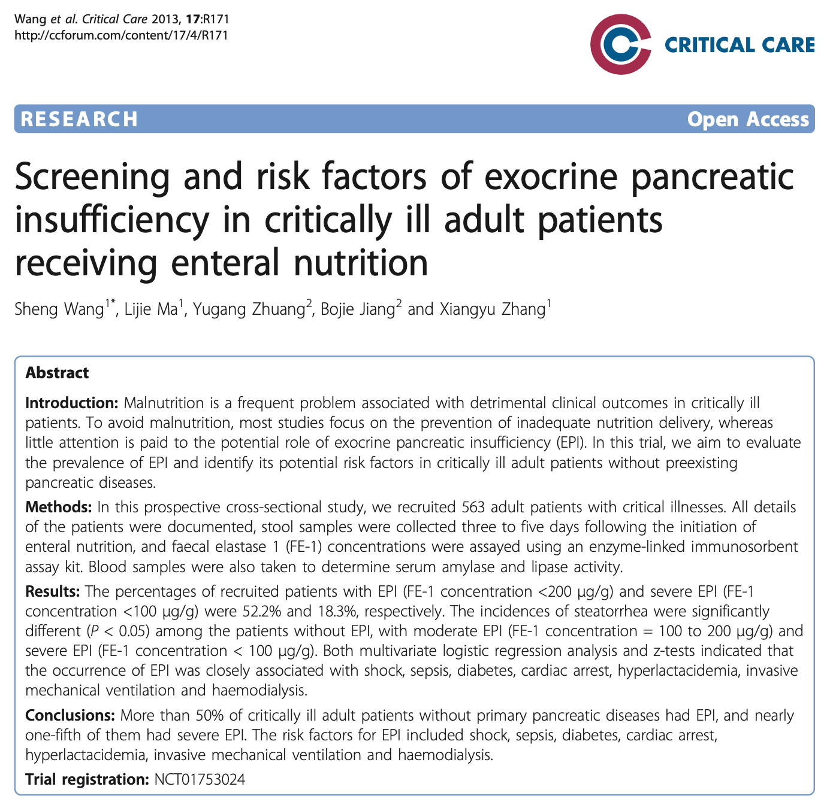
EPI in Critical Illness
The only primary research article on the topic to date
Impetus: Malnutrition is common in the ICU, associated with poor outcomes.
  Most efforts aimed at enhancing caloric intake
  No assessment of role of EPI
Aims:
  Determine prevalence
  Risk factors
Wang et al, Crit Care 2013

Slide 61
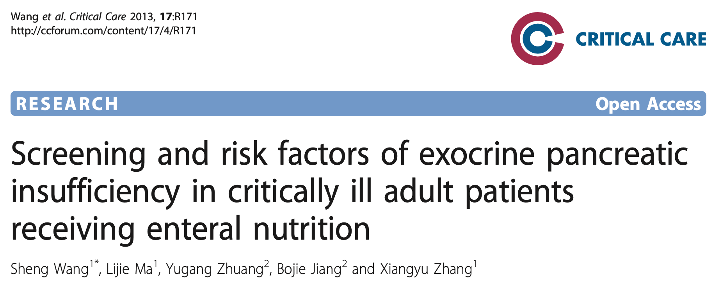
Methods
Prospective cross-sectional study
Mixed med-surg ICUs at academic Shanghai hospital x1 yr
Pts on TF, expected to stay >3d in ICU
Baseline demographic & clinical characteristics recorded
Stool samples obtained 3-5d after TF initiation for fecal elastase
Serum amylase, lipase
General outcomes

Slide 62
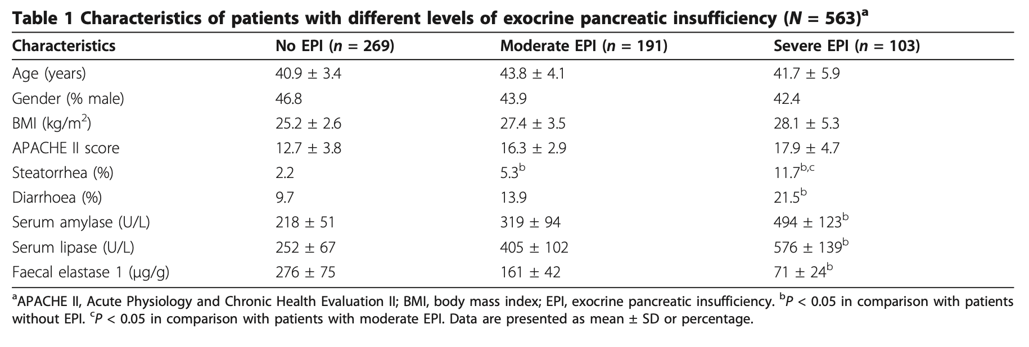
Results
N=563
TF advanced and bowel regimens per local protocol
Notes:
There were no differences in age, gender & BMI, but patients with moderate (FE<200) and severe EPI (FE<100) were sicker with a higher APACHE II score.
Also, they experienced more steatorrhea, diarrhea, and had higher amylase & lipase in their serum, as well as lower FE in their stools.
Steatorrhea: loose, frothy, foul-smelling and buoyant stools
Diarrhea: >= 3 loose stools/day

Slide 63
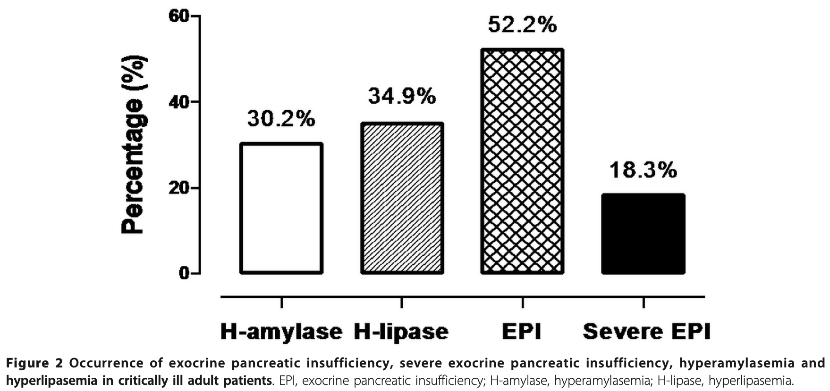
EPI Incidence
N=563
Moderate EPI (FE <200) = 191
Severe EPI (FE <100) = 103
52.2%
Notes:
Also hyperamylassemia was noted in 30%, hyperlipasemia in 35%, and severe EPI in 18%.
Pancreatic involvement in critical illness is far more common than we realize or look for.
How many in the room ask for pancreatic assessment if pts don’t tolerate TF?

Slide 64
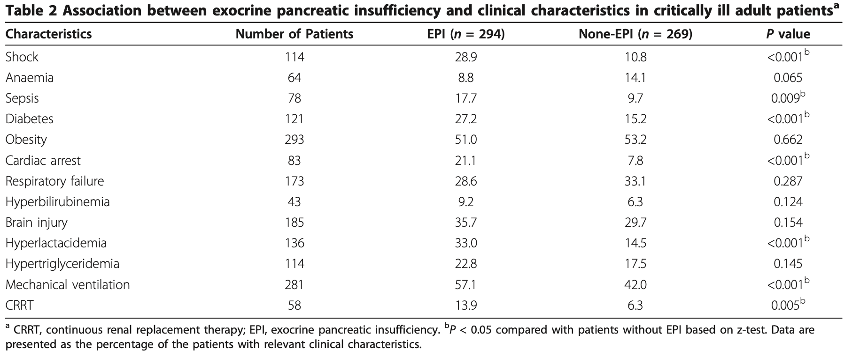
Clinical Characteristics
Notes:
When the investigators looked at the specific characteristics of the patients who developed EPI vs those who did not they noted that they had more of:

Slide 65
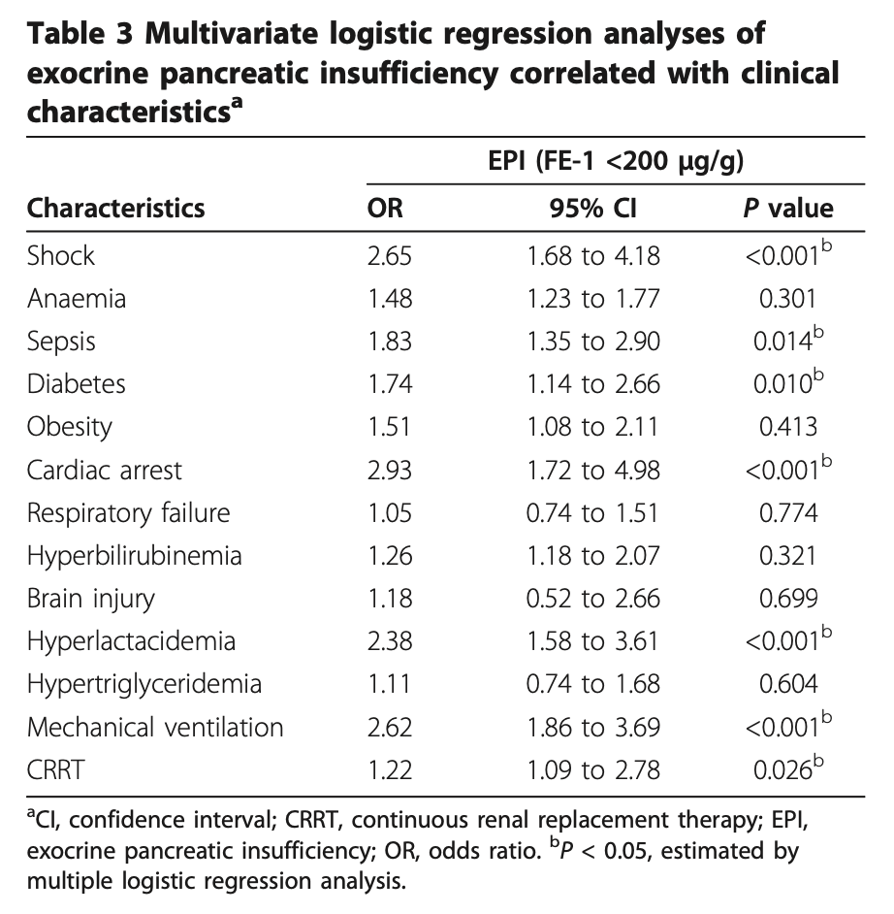
Risk Factors for EPI
Notes:
On their regression analysis for independent risk factors for EPI they identified exactly the same parameters for EPI.

Slide 66
When to suspect?
Suspect EPI in very sick diabetic patient in the ICU with sepsis or shock (on pressors), (with high lactate), on mechanical ventilation, on CRRT, possibly after cardiac arrest, who is not ’tolerating TF’.
Notes:
Based on the above:

Slide 67
Effect of ILC on Enteral Nutrition Delivery in the SICU
Cleveland Clinic retrospective SICU study
Hypothesis: ILC improves TF delivery (% TF delivered over prescribed) and decreases diarrhea episodes
All pts in SICU on TF+ILC or TF+fiber (2017-2021)
Excluded: pts with CF
SCCM 2024
Notes:
Presented earlier this year at SCCM 2024

Slide 68
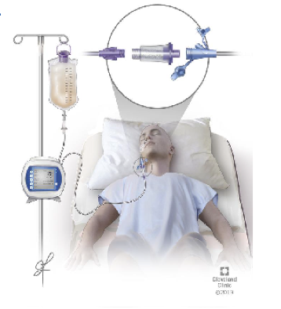
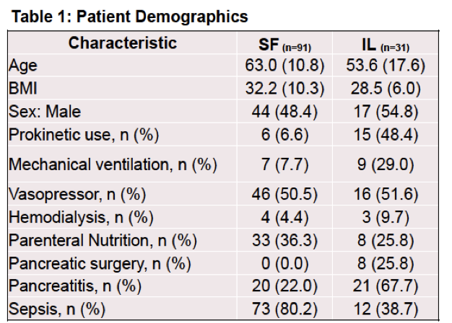
Effect of ILC on Enteral Nutrition Delivery in the SICU
N=122
SCCM 2024
Notes:
Mean age was 61
50% were female
Most prevalent confounderw were pressors, sepsis, use of prokinetics, mechanical ventilation, and pancreatic pathology.

Slide 69
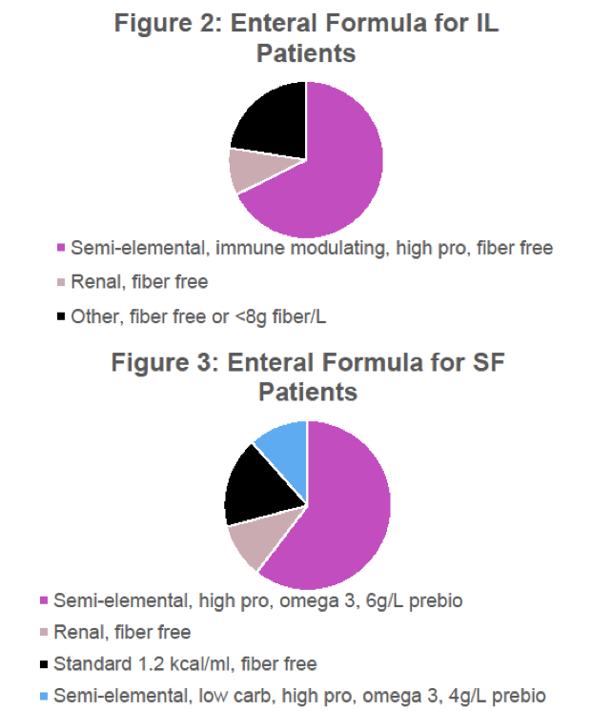
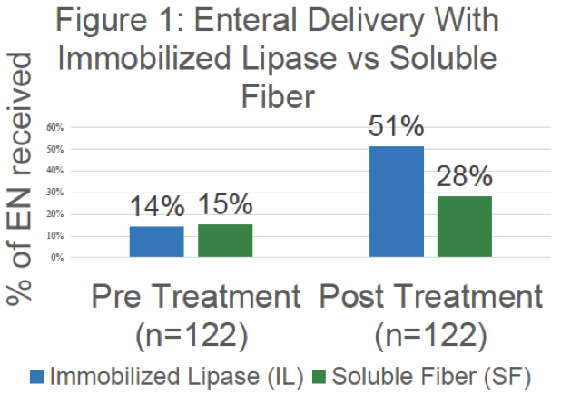
ILC improves enteral nutritional delivery
SCCM 2024
Notes:
While both treatments improved Enteral nutrition delivery, patients on ILC were able to receive almost 2x prescribed nutrition.
Both sets of patients were on similar TF prescriptions.

Slide 70
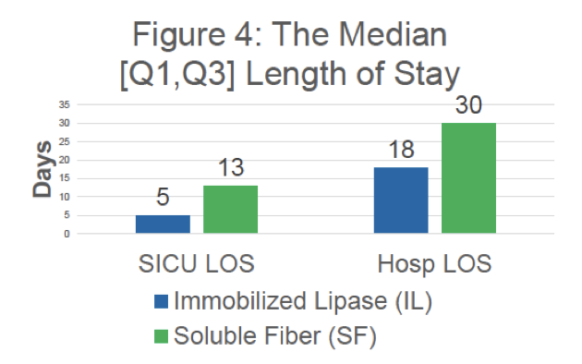
Shorter ICU, hospital LOS with ILC
SCCM 2024
Notes:
Pts on ILC had shorter ICU & hospital LOS. (But remember, the ones treated with fiber were sicker at baseline)

Slide 71
Shorter ICU, hospital LOS with ILC
ILC adjusted mean difference in TF delivery:
  13% (95% CI -5% - 31%, p=0.166)
ILC adjusted mean difference in daily BMs:
  -1.4 (95% CI -4.4 – 1.7, p=0.365)
SCCM 2024
Notes:
No statistical significance in the number of calories or BMs, in this small study.

Slide 72
Our own pilot double-blind PRCT
Pts with MOF at tertiary center MICU & SICU
Randomization to ILC or placebo, N=30
Hypothesis: ILC enhances TF delivery
Secondary objectives:
  Incidence of EPI in MOF
  Association between EPI & EnPI
Kasotakis et al 2025
Notes:
Investigator-initiated, industry funded
MOF: on mech ventilation AND pressors
Results by this time next year

Slide 73
Clinical Scenario
61F in the MICU x4 days after episode of community acquired pneumonia, now on mechanical ventilation, ARDS, sepsis, on Norepi.
Now lactate cleared, Cr 1.1 -> 4.5, team considering CRRT
Norepi now 8 mcg/hr, NG inserted, TF initiated.
Within 8h, pt with abdominal distention, diarrhea, gastric residuals 250 cc.

Slide 74
Most appropriate next step:
Hold TF, until off pressors
Hold TF, prescribe TPN
Switch TF to less osmolar formula
Continue TF adding fiber, prokinetic
Continue TF adding fiber, send fecal elastase

Slide 75
Most appropriate next step:
Hold TF, until off pressors
Hold TF, prescribe TPN
Switch TF to less osmolar formula
Continue TF adding fiber, prokinetic
Continue TF adding fiber, send fecal elastase

Slide 76
Clinical Scenario
Fecal management system inserted
Diarrhea improved slightly with fiber
Gastric residuals 450
Fecal elastase 82

Slide 77
Most appropriate next step:
Hold TF until improved gastric residuals
Hold TF until improved gastric residuals, then refeed those
Hold TF, start ILC
Continue TF, start ILC
Start TPN

Slide 78
Most appropriate next step:
Hold TF until improved gastric residuals
Hold TF until improved gastric residuals, then refeed those
Hold TF, start ILC
Continue TF, start ILC
Start TPN

Slide 79
Learning Objectives / Summary
Describe Clinical Presentation of EPI in critical illness
  Presents like TF intolerance: steatorrhea, diarrhea, bloating, abd distention/pain, elevated gastric residuals
  Very common
  Remarkably undiagnosed
Accurately diagnose EPI in critical illness
  Fecal elastase <200
Appropriately manage EPI in critical illness
  ILC in line with enteral nutrition
Questions ?

